Slide 1
sUAS Deployable Acoustic Direction-Finding Module
September 2017
Kory Olney
USF Mechanical Engineering

Slide 2
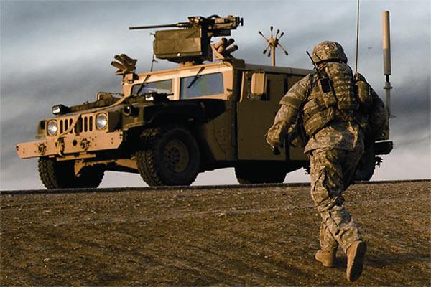
Contents
Abstract
Current Progress
Similar concepts
3d modeling
Algorithms
Hardware
Software
Future Developments
Projected timeline
Projected Costs

Slide 3
Abstract
Technology has become a crucial tool in assisting the modern day warfighter perform a safe and successful mission. The rise in availability of small unmanned aerial systems (sUAS) has changed the way battles are fought. These sUAS can be leveraged to deploy a variety of sensors to the battlefield in order to provide our warfighters as much information about their surroundings as possible. The acoustic characteristics of a battlefield are of the utmost importance to the warfighter. Using the methods of time difference of arrival (TDOA) and the Fast Fourier transform, estimations can be made of the direction of arrival (DOA) of a gunshot as well as the type of weapon being fired.

Slide 4
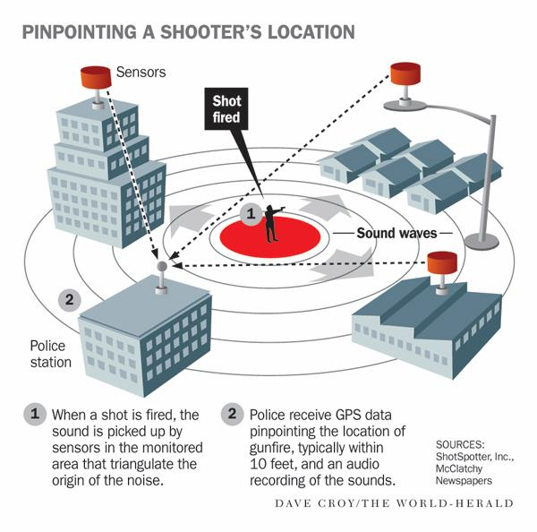
Current Progress – Similar Concepts
Raytheon Boomerang
ShotSpotter

Slide 5
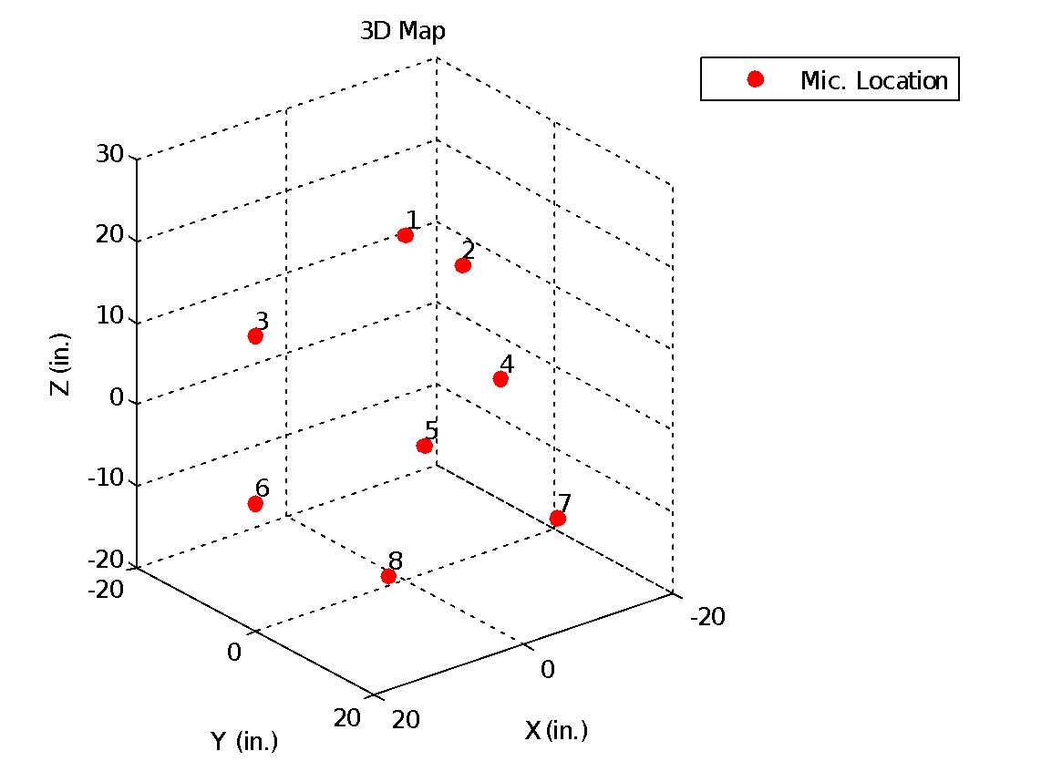
Current Progress – 3D Modeling
Table 1: Cartesian coordinates of Mics (cm)
Microphone | X (cm) | Y (cm) | Z (cm)
1 | 0 | 0 | 22.595
2 | -13.836 | -7.989 | 11.297
3 | 13.836 | -7.989 | 11.2975
4 | 0 | 15.977 | 11.2975
5 | -11.2975 | -11.2975 | -11.2975
6 | 11.2975 | -11.2975 | -11.2975
7 | -11.2975 | 11.2975 | -11.2975
8 | 11.2975 | 11.2975 | -11.2975
Figure 1: 3d Map of mic Position in Matlab

Slide 6
Current Progress- Algorithms

Slide 7
Current Progress - Hardware
NI myRIO – Microcontroller
FPGA
LabVIEW
On board 40 MHz Oscillator
Redundant accelerometers
Plenty of digital ports for flexibility
TI 8 Channel Synchronous ADC
Delta Sigma
SPI output
24 Bit resolution
2’s complement
Serial and parallel data formats
Figure 2: DOA Module aboard sUAS

Slide 8
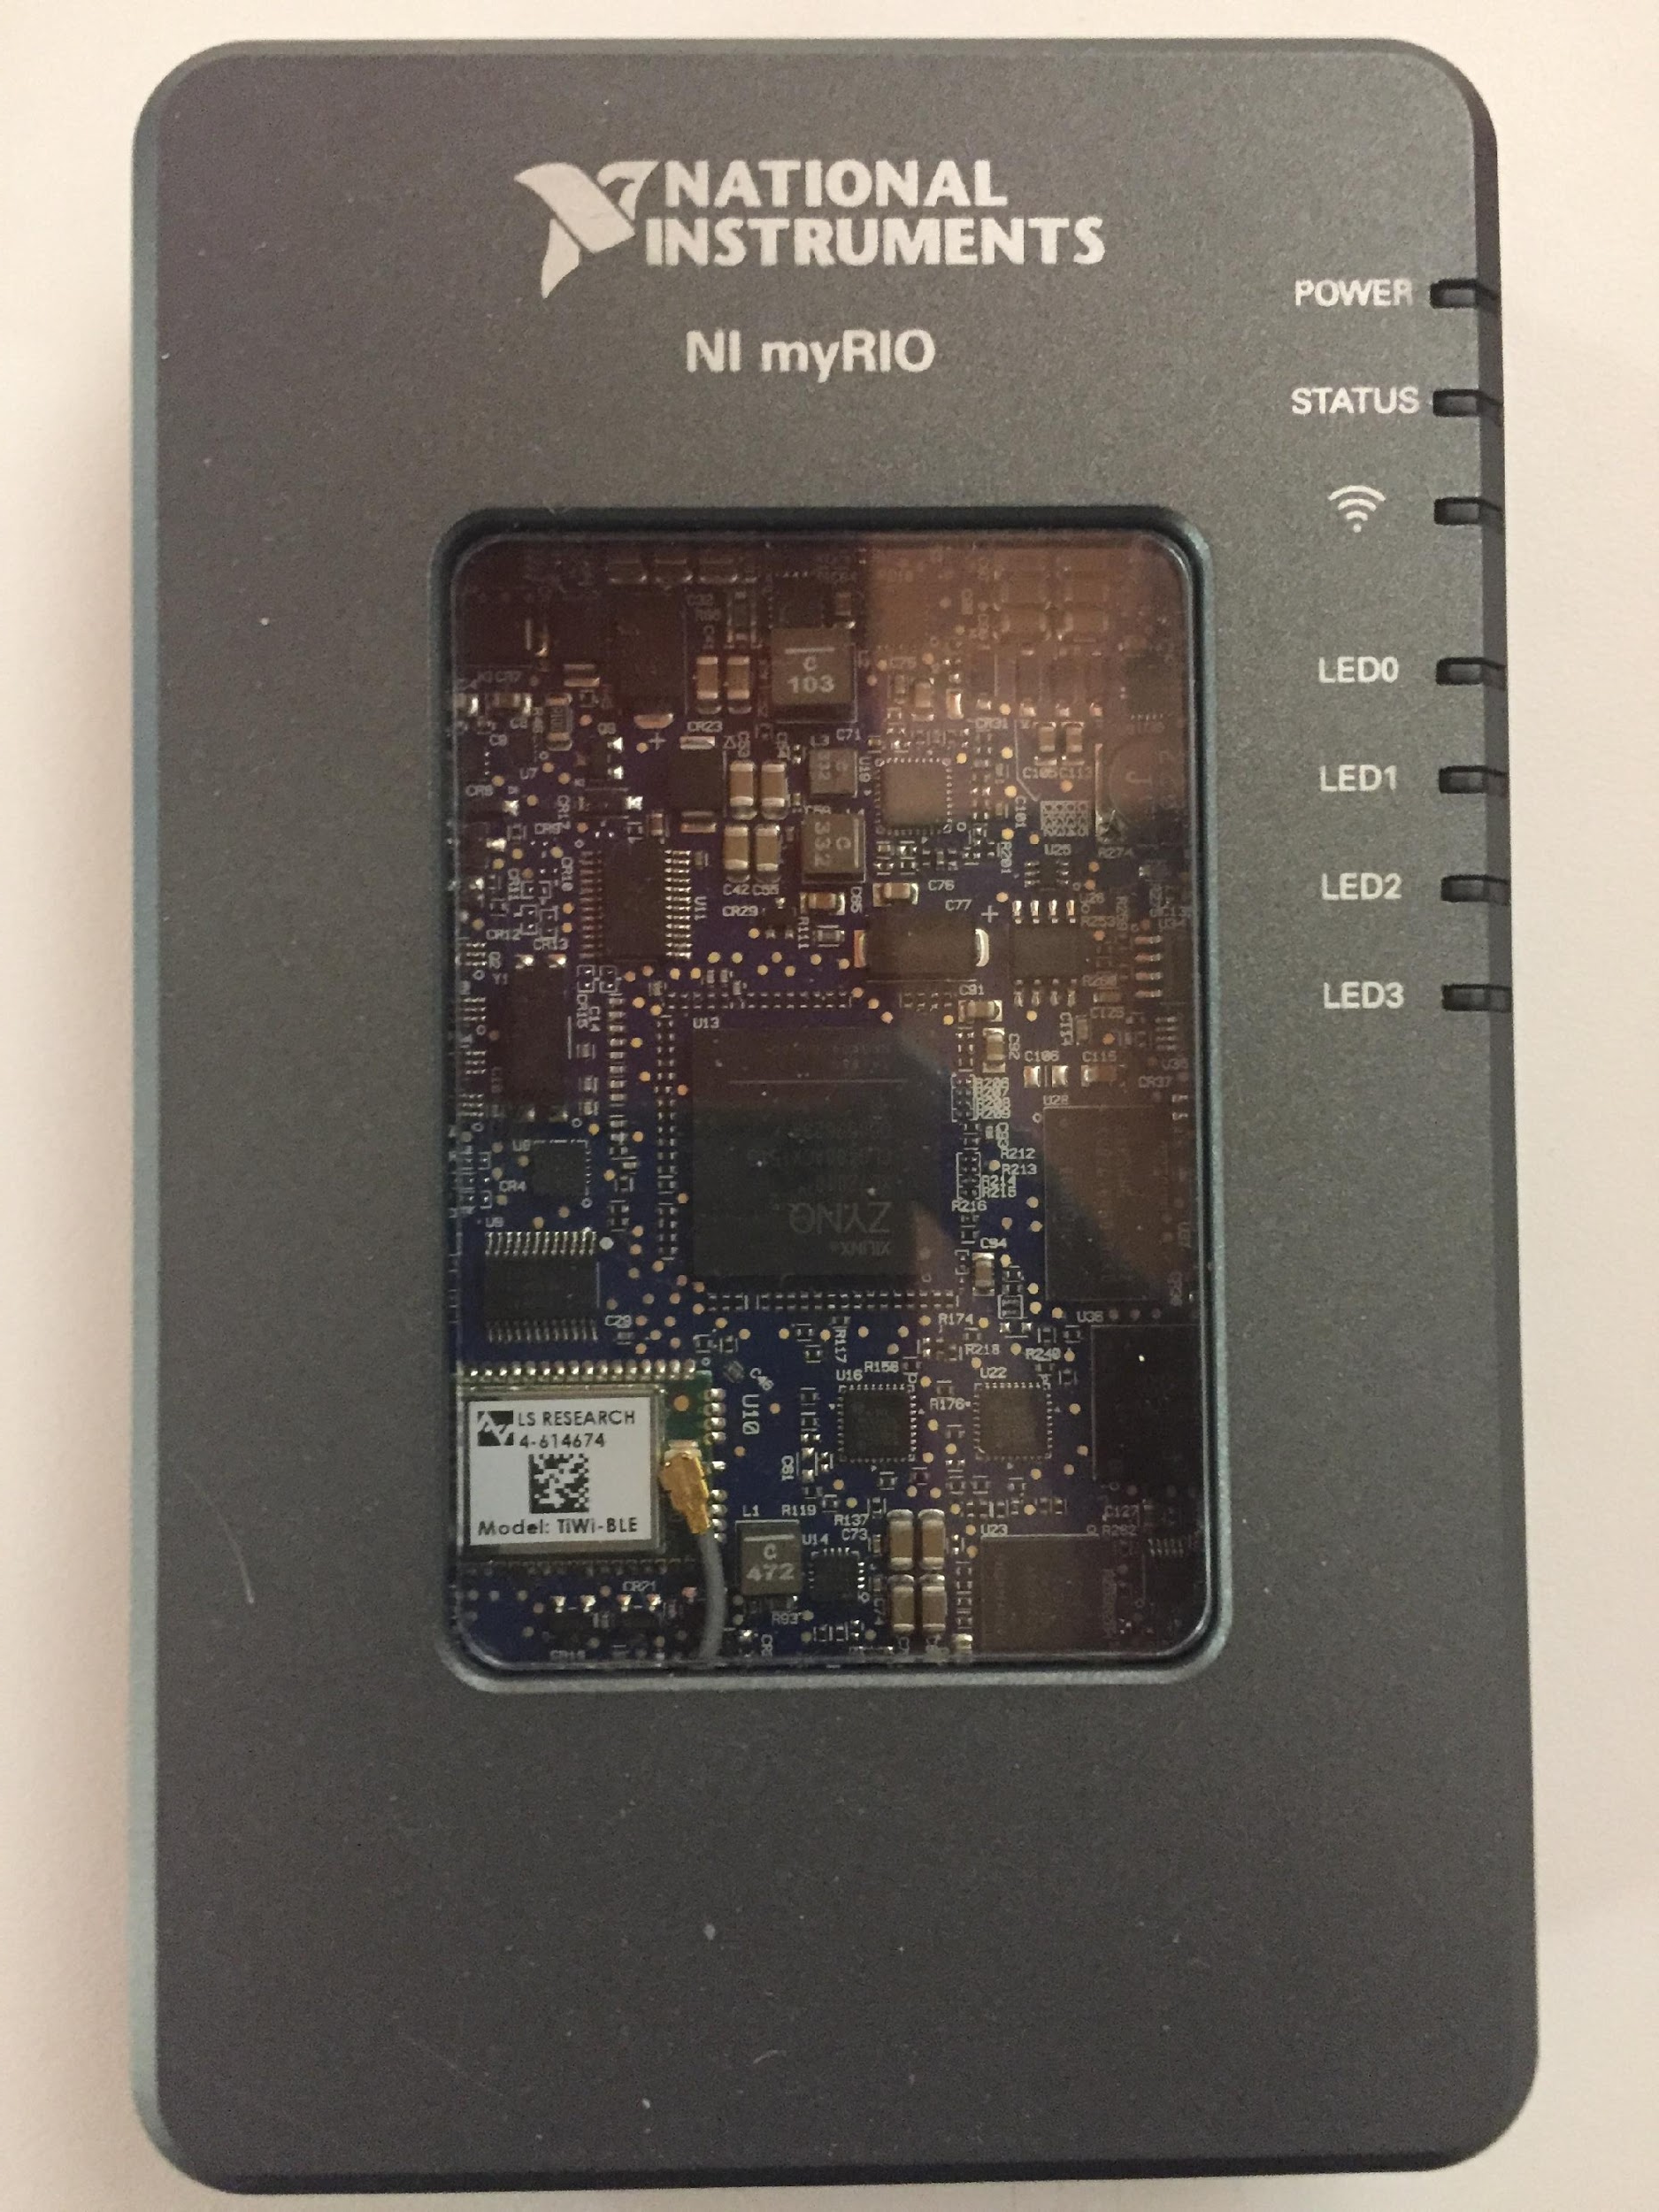
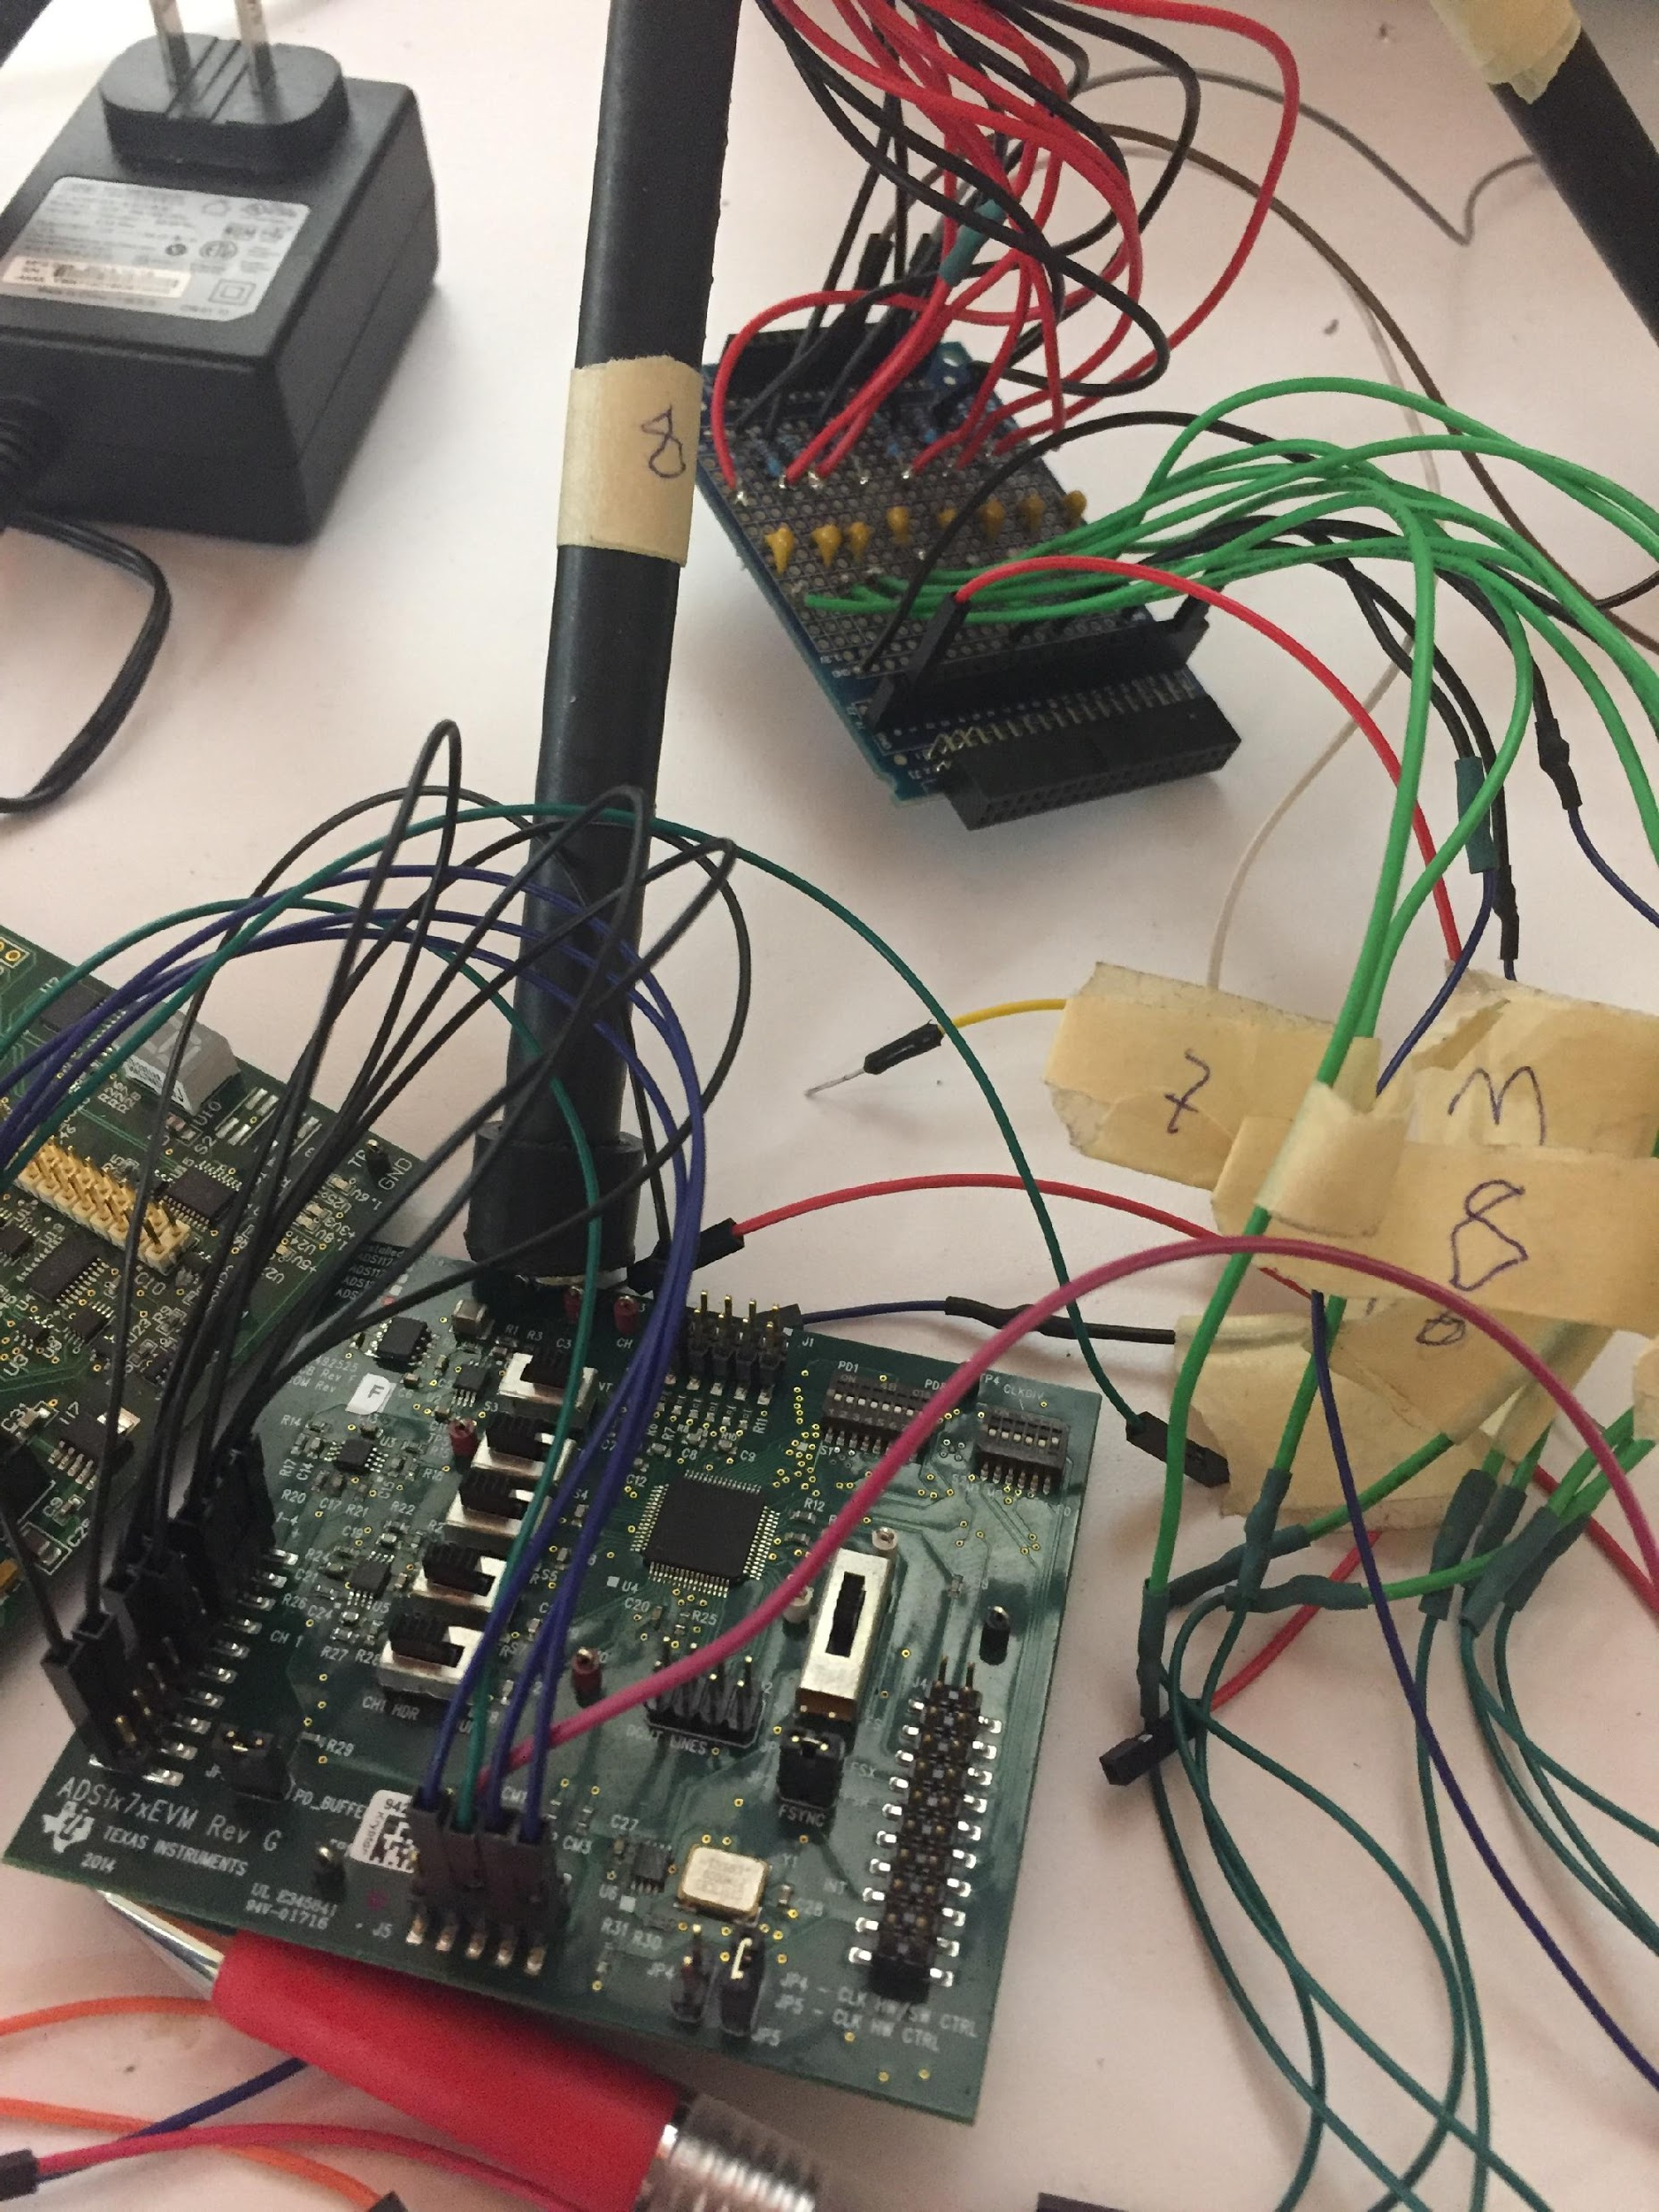
Current Progress - Hardware
Figure 3: myRIO microcontroller
Figure 4: ADC TI ADS1278

Slide 9
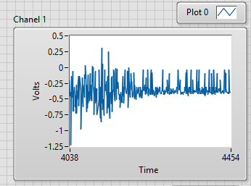
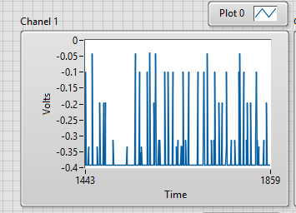
Current Progress - Software
LabVIEW
User- friendly development interface
Large selection of toolboxes
FPGA Capabilities
Frequency analysis
Figure 6: : Repaired Signal after Excitation of Mic 1
Figure 5: Channel 1 SPI Clock Misalignment

Slide 10
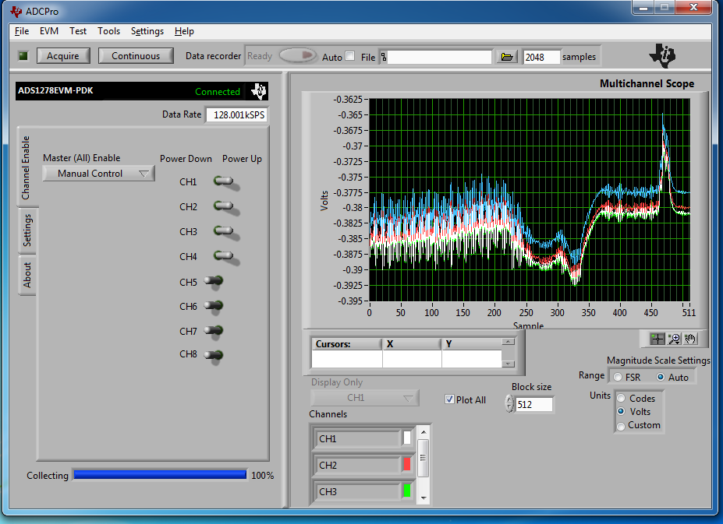
Current Progress - Software
Currently working on implementing correct data communication between ADC and myRIO via FPGA
FPGA
Higher throughput
Lower energy consumption
Supplied clock to ADC at max 32MHz
Samples at CLK/4
Max Sampling at 8 MHZ
Max Data Rate = 125,000 (SPS)
Serial 15,625 SPS/Channel
Pixhawk II Flight Controller
Intel Edison expansion board

Slide 11
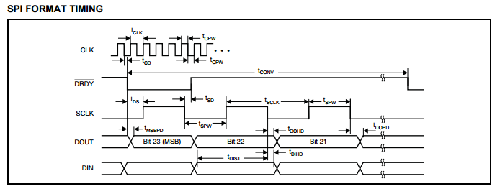
Current Progress – SPI
Figure 7: SPI Format Timing [3]
Figure 8: Eight Channel SPI Data Format [3]

Slide 12
Future Developments
Finalize Data Communication over SPI
Gunshot Analysis and Characterization
Noise-canceling Implementation (Acoustic and EMI)
Machine Vision
Weaponization
Collective Analysis using Multiple Modules

Slide 13
Projected Timeline
Finalize proper data communication – November 2017
Perform Digital Signal Processing – November 24, 2017
Evaluate process aboard an operating UAS – December 2017
Record an analyze various gunshots at the Range – January 2017
Adjust hardware and software to minimize error
Begin Machine Vision development – February 2017

Slide 14
Projected Costs
All of the crucial hardware that is required for this project has already been acquired.
Future costs should be no more than $600
These may include small electrical components necessary for the operation of the UAS
Propellers $40
Motors $ 200
Power distribution $100
Camera: $150

Slide 15
References
https://www.raytheon.com/capabilities/products/boomerang/
http://www.shotspotter.com/
[1] Xunxue Cui, Kegen Yu, and Shongsheng Lu “Direction Finding for Transient Acoustic Source Based on Biased TDOA Measurement” IEEE Transactions on Instruments and Measurement, Vol. 65, No.11, November 2016
[2] Texas Instruments, “ADS1x7xEVM-PDK,” SBAU197A User’s Guide, February 2012 [Revised January 2016]
[3] Texas Instruments, “Quad/Octal, Simultaneous Sampling, 24-Bit Analog-to-Digital Converters,” SBAS37F datasheet, June 2007 [Revised February 2011]

