Slide 1
LabVIEW Acoustic Filtering Resources

Slide 2
Getting Started
Looking into implementing different filter types on both the host and FPGA
This includes analyzing real time and recorded signals
Adaptive LMS on the DSP and FXP FIR on the FPGA

Slide 3
FPGA Simulation
Testing and Debugging LabVIEW FPGA Code
Debugging FPGA VIs Using Simulation Mode (FPGA Module)
Using the LabVIEW FPGA Desktop Execution Node
There are several methods for desktop PC simulation of FPGA IP, but for high-throughput DSP algorithms in the single-cycle timed loop, one specific method tends to be the most efficient. This technique runs the FPGA VI on the host computer in a “dataflow-accurate” manner. Dataflow-accurate basically means that all dataflow paradigms are obeyed, and the simulation is cycle-accurate within the context of a single SCTL. Furthermore, the simulation is also bit-true, meaning that the results are numerically identical to those obtained when running on FPGA hardware after a successful compilation. In addition to the FPGA VI running on the host, there is also a separate host VI which serves as the test bench, sending stimulus waveforms to the FPGA VI, and capturing and displaying the results. This VI can often leverage significant components of the existing host-based behavioral simulation described above.
To execute the FPGA VI on the host in simulation mode, simply right click on the FPGA target in the LabVIEW project, then select “Execute VI on -> Development Computer with Simulated I/O”.
Simulate FPGA Targets Using the Project Explorer with LabVIEW **

Slide 4
Relevant Examples - FPGA Filters
Single-Rate FPGA
Lowpass FPGA
Notch Filter FPGA
comm sys.
ANC
ECG Processing

Slide 5
LabVIEW 2014 Advanced Signal Processing Toolkit Help
directory and opening readme_ASPT.html.
Advanced Signal Processing Toolkit Example VIs—Refer to the labview\examples\Time Frequency Analysis, labview\examples\Time Series Analysis, and labview\examples\Wavelet Analysis directories for example VIs that demonstrate common tasks using the Time Frequency Analysis Tools, Time Series Analysis Tools, and Wavelet Analysis Tools respectively. You also can access these VIs by selecting Help»Find Examples from the pull-down menu and selecting Toolkits and Modules»Time Series Analysis, Toolkits and Modules»Time Series Analysis, and Toolkits and Modules»Wavelet Analysis in the NI Example Finder window.
Discrete Wavelet Transform
TFA Online STFT Spectrogram VI
Time Frequency Analysis
Time series Analysis
Wavelet Analysis

Slide 6
LabVIEW 2015 Digital Filter Design Toolkit Readme
The Digital Filter Design Toolkit includes the Digital Filter Design VIs and the Adaptive Filters VIs to provide a collection of digital filter design tools, including adaptive filter design tools, to supplement the LabVIEW Full Development System. The Digital Filter Design Toolkit helps you design digital filters and filter banks without requiring you to have advanced knowledge of digital signal processing or digital filtering techniques. With the Digital Filter Design Toolkit, you can design and analyze floating-point and fixed-point digital filters and filter banks. With the Digital Filter Design Toolkit, you also can design and analyze floating-point and fixed-point adaptive filters. You also can simulate fixed-point digital filters, including fixed-point adaptive filters.
Without prior knowledge about programming in LabVIEW, you can use the Digital Filter Design Express VIs to interact graphically with filter specifications to design appropriate digital filters and filter banks.
The Digital Filter Design VIs help you design the following filters and filter banks:
Digital finite impulse response (FIR) or infinite impulse response (IIR) filters—You can use the VIs to analyze the characteristics of the digital filter, change the implementation structure of the digital filter, and process data with the digital filter. In addition to the floating-point support, the Digital Filter Design VIs also help you create a fixed-point digital filter model, analyze the characteristics of the fixed-point digital filter, simulate the performance of the fixed-point digital filter, and generate fixed-point C code, integer LabVIEW code, or LabVIEW field-programmable gate array (FPGA) code for NI FPGA targets.
Floating-point multirate digital filters—You can use the VIs to design a floating-point single-stage or multistage multirate filter, analyze the characteristics of the floating-point multirate filter, and process data with the floating-point multirate filter. In addition to the floating-point filter design, the Digital Filter Design VIs also help you create a fixed-point multirate filter, analyze the characteristics of the fixed-point multirate filter, simulate the behavior of the fixed-point multirate filter, and generate LabVIEW FPGA code from the fixed-point multirate filter for FPGA targets.
Filter banks—You can use the VIs to design a 2-band quadrature mirror filter (QMF) or M-band cosine-modulated filter bank, analyze the characteristics of a filter bank, decompose or reconstruct signals with filter banks, retrieve filter bank parameters, and create a filter bank from a prototype filter.
The Adaptive Filters VIs help you design a floating-point and fixed-point adaptive filter for different applications and with different adaptive filter algorithms. You can use the Adaptive Filters VIs to create an adaptive filter with the following adaptive algorithms:
Least mean squares (LMS) and the variants, such as normalized LMS, leaky LMS, normalized leaky LMS, sign LMS, and fast block LMS
Filtered-x LMS and normalized filtered-x LMS
Recursive least squares (RLS) and QR decomposition-based RLS (QR-RLS)
You can apply the adaptive filter that you create to applications like adaptive noise cancellation, adaptive echo cancellation, and system identification. You also can create and implement a fixed-point adaptive filter on FPGA targets.
In addition to the graphical tools for digital filter design, the toolkit also provides Digital Filter Design MathScript RT Module functions that LabVIEW MathScript supports. These functions enable you to design filters in a text-based environment. You must install the LabVIEW MathScript RT Module to use the Digital Filter Design MathScript RT Module functions.

Slide 7
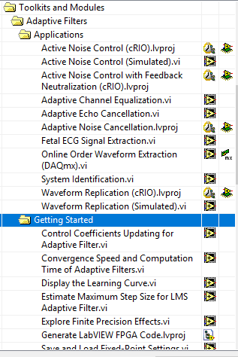
LabVIEW 2015 Digital Filter Design Toolkit Readme
Select Help»Find Examples from LabVIEW to launch the NI Example Finder. Navigate to the Toolkits and Modules»Digital Filter Design folder and the Toolkits and Modules»Adaptive Filters

Slide 8
Example - FPGA IIR Single Rate
labview\examples\Digital Filter Design\Fixed-Point Filters\Single-Rate

Slide 9
Example - FPGA Filter Lowpass
labview\examples\Digital Filter Design\Case Studies\Single-Rate Filter\Lowpass

Slide 10
Example - Xilinx FIR Compiler
High Throughput FPGA course, exercise 5-1

Slide 11
Example - Interleaving with Notch IIR
labview\examples\Digital Filter Design\Case Studies\Notch Filter\Notch

Slide 12
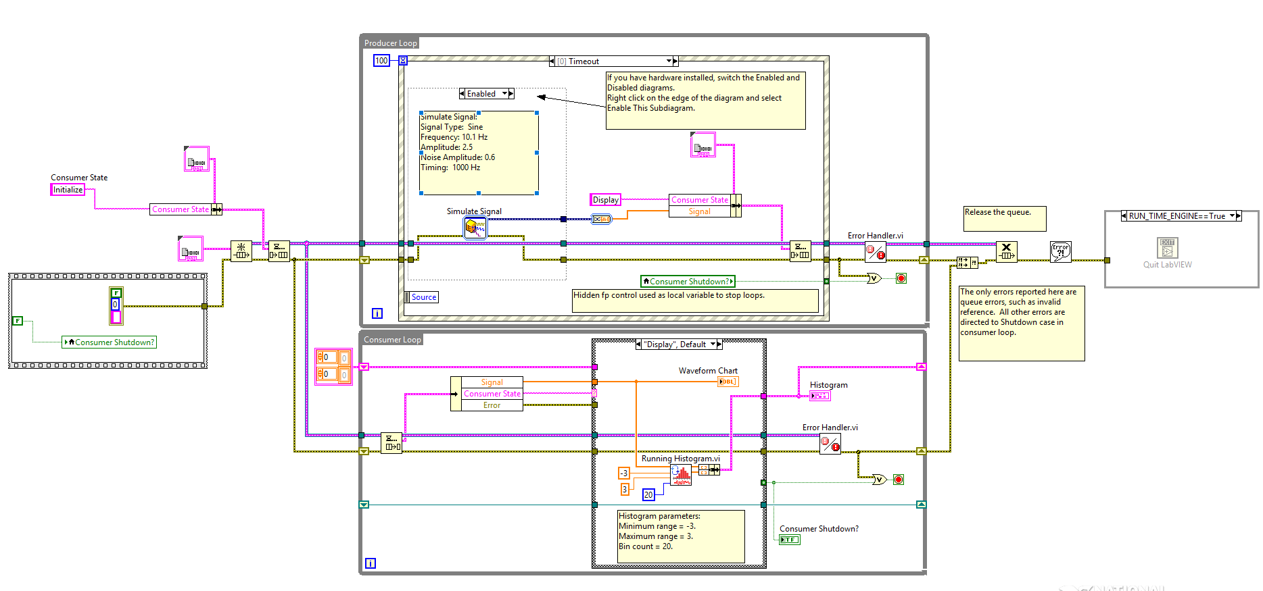
Histogram

Slide 13
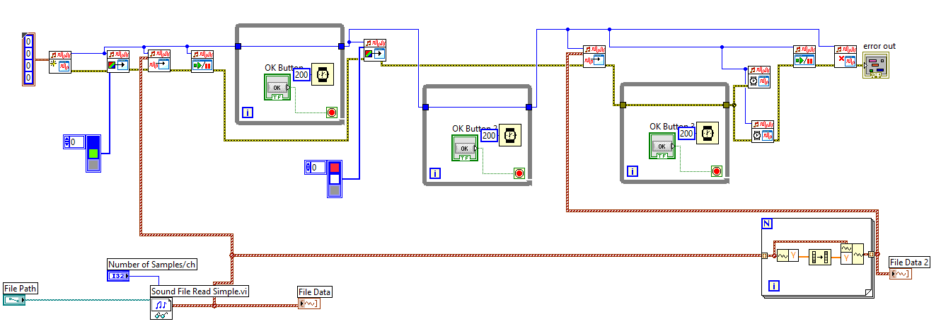
Visualizer

Slide 14
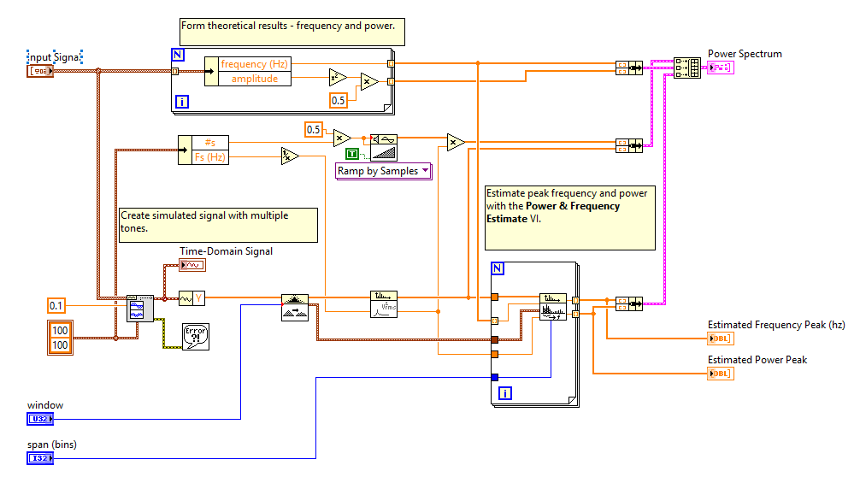
Power and Frequency

Slide 15
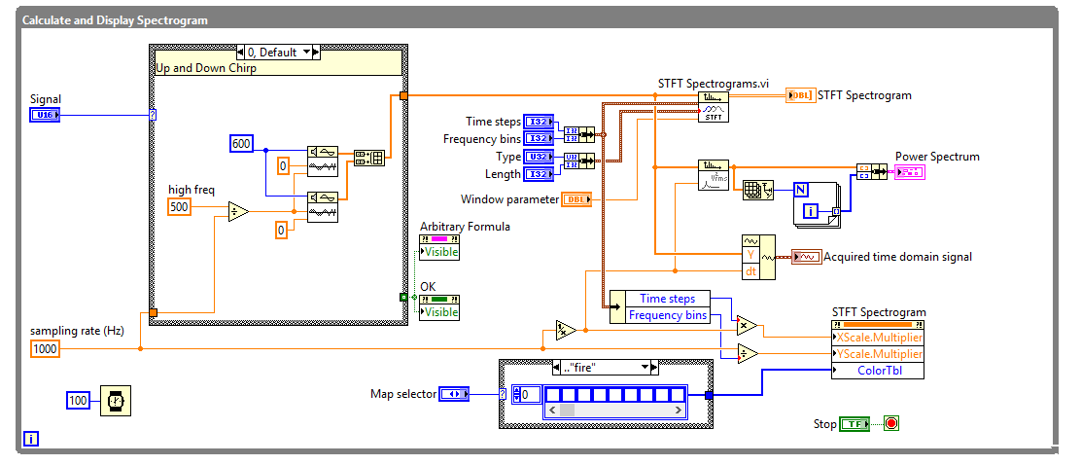
STFT Spectrogram -ex

Slide 16
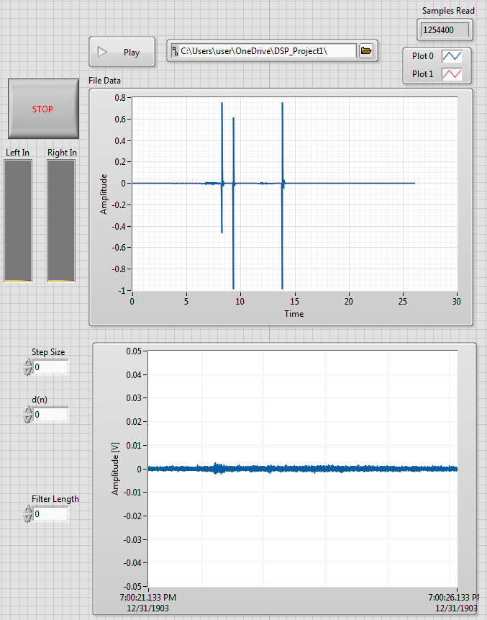
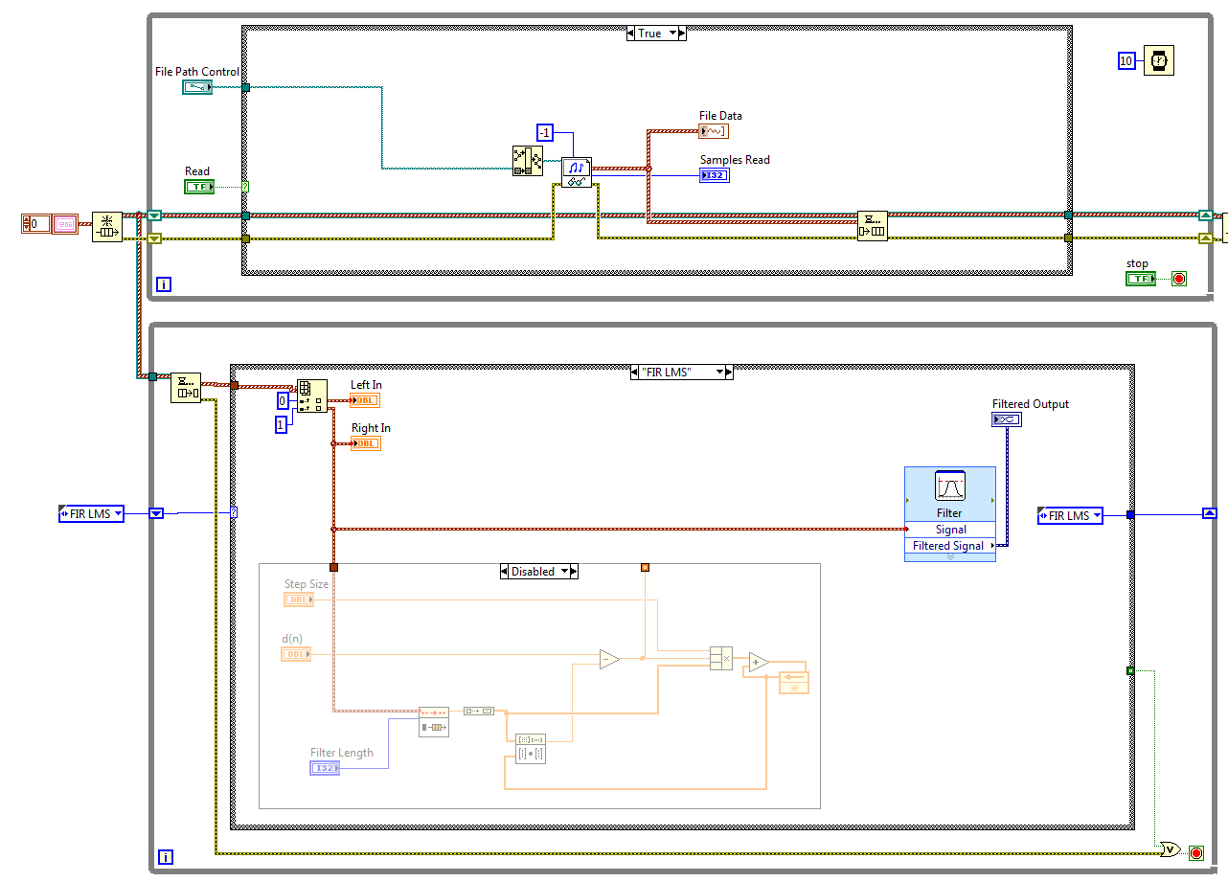
LabVIEW PC Application

Slide 17
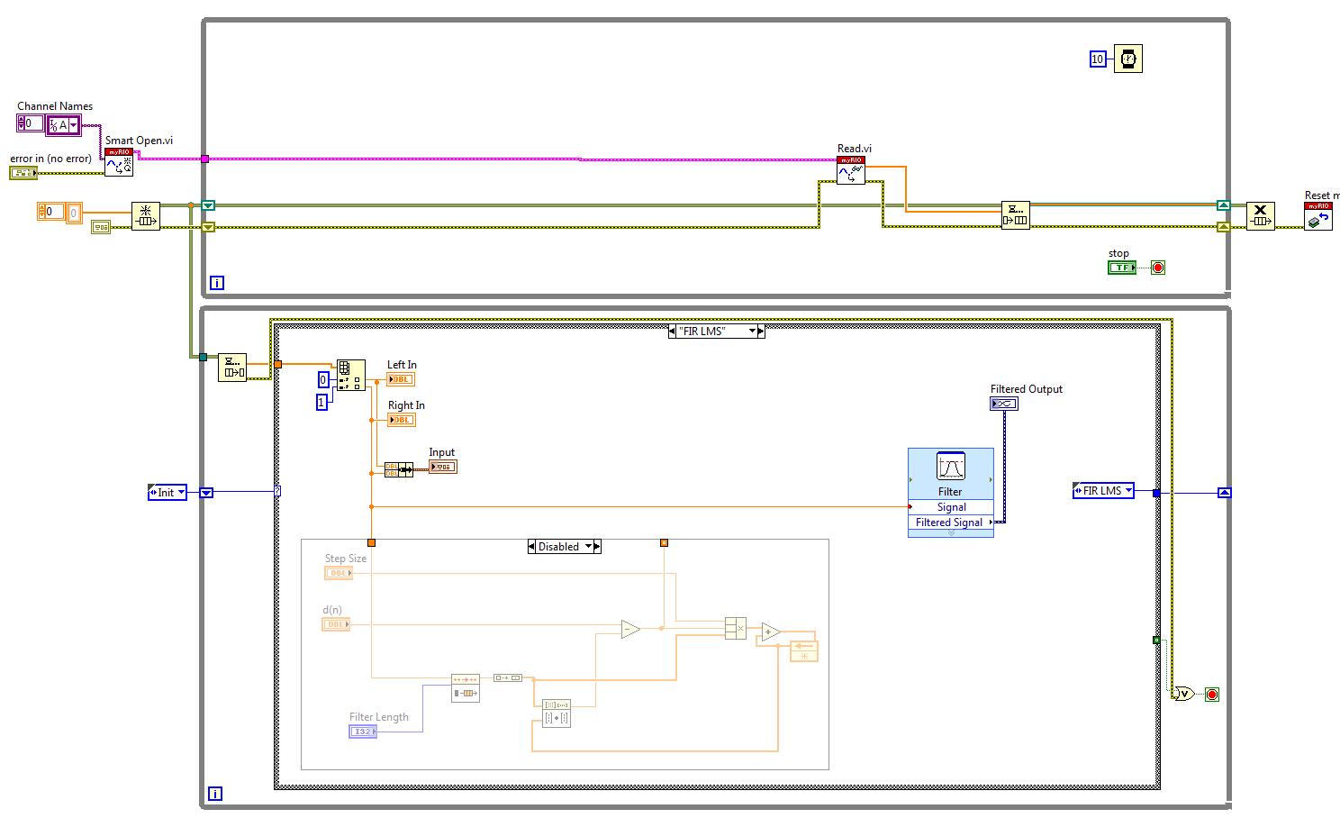
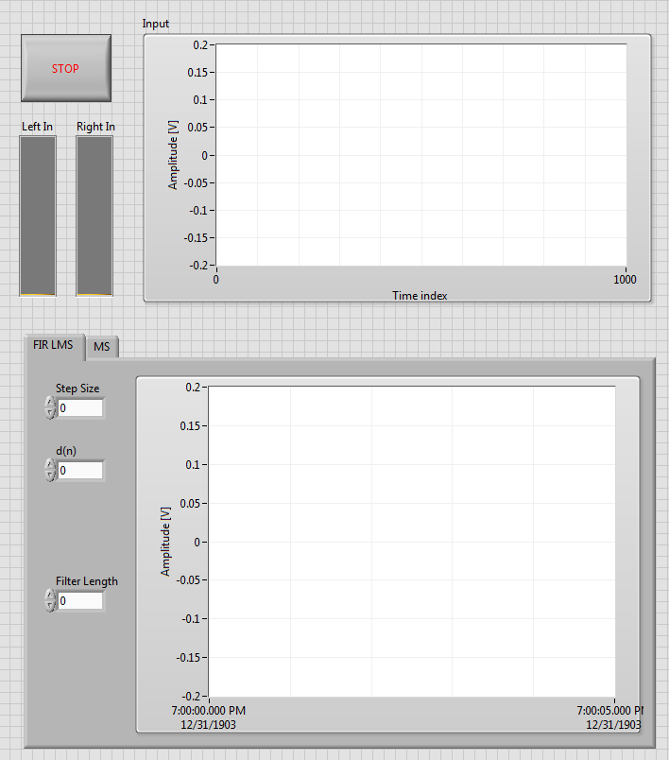
LabVIEW Embedded/RIO Application

Slide 18
Digital Filter Design Toolkit
Generating LabVIEW FPGA Code (Digital Filter Design Toolkit), **
Designing Ultra-High Throughput FIR Filters with no Multiplier on NI FPGA Platforms
Working with LabVIEW Filtering VIs and the LabVIEW Digital Filter Design Toolkit VIs
Teaching FIR Filter Design Using the Digital Filter Design Toolkit (Windowing)
Getting Started with the NI LabVIEW Digital Filter Design Toolkit *

Slide 19
High Throughput
NI High Throughput Add-on for myRIO

Slide 20
FPGA Filtering - Xilinx FIR IP
Attempting to implement the Xilinx FIR Compiler on the FPGA
Polyphase Interpolation Walkthrough **
An Introduction to High-Throughput DSP in LabVIEW FPGA **
FIR compiler for Beginners
If you want to generate LabVIEW FPGA code from an IIR filter, National Instruments recommends you use the IIR Cascaded Second-Order Sections Form II Transposed structure for this filter.
The LabVIEW FPGA code you generate with the LabVIEW Digital Filter Design Toolkit supports only the fixed-point data type.
Refer to the LabVIEW FPGA Code Generation VI in the labview\examples\Digital Filter Design\Fixed-Point Filters\Single-Rate directory for an example that demonstrates how to generate LabVIEW FPGA code from a fixed-point filter.
Refer to the LabVIEW FPGA Code Generation VI in the labview\examples\Digital Filter Design\Fixed-Point Filters\Single-Rate directory for an example that demonstrates how to generate LabVIEW FPGA code from a fixed-point filter.

Slide 21
Xilinx IP Cont’d
The coefficients designed with the Digital Filter Design Toolkit can be easily imported into the Xilinx FIR Compiler by using a helper example VI which outputs a *.coe file. This helper VI can be found here:
C:\Program Files\National Instruments\LabVIEW 201*\examples\Digital Filter Design\Fixed-Point Filters\Multirate\Export Multirate FIR Coef to Xilinx COE File.vi
IP LogiCORE FIR Compiler v5.0
Xilinx PDF
Simulation/integration
Example counter
Coregen

Slide 22
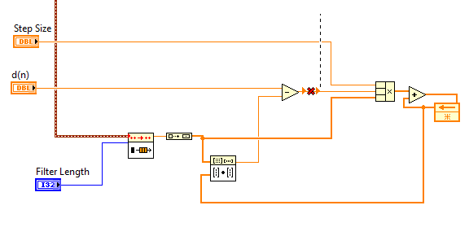
LMS Implementation

Slide 23
Results

Slide 24
Misc. Links
Oversampled Frequency Measurement Reference Example for LabVIEW FPGA **
Deciding Which Data Type to Use in FPGA Designs
LabVIEW FPGA Floating-Point Data Type Support
FPGA - Floating-Point math operations
Using the Single-Precision Floating-Point Data Type (FPGA Module)
DSP48E Example: Creating an n-Tap FIR Filter (FPGA Module) **

