Slide 1
Notes for ADFing Project-LV FPGA
Kory Olney
USF Mechanical Engineering
2018

Slide 2
FPGA Tips
A tip on multiplication and division on FPGA: It takes a long time to do proper divisions on FPGA, so if pipelining and delays are not acceptable you must avoid this! Bear in mind that multiplication and division by powers of 2 (i.e. a = b*2^n) is fast when working with integer types due to the magic of binary! Multiplying an integer by 2, 4, 8 etc or 1/2, 1/4, 1/8 is very quick. There are loads of similar tricks with binary. For this reason I try to stay in integer space on the FPGA rather than using FXP.
Looking at the code you have sent, the way you handle reading information from the DMA was a little confusing to me. To keep the channels consistent, you have to make sure that the DMA is being read in multiplies of the number of channels all the time, then decimate the output array.
I was thinking about it still and I have got the idea to change the size of the DMA buffer on the side of myRIO. I extended the buffer from 1023 elements to 2047 and it is working well and I can change the sampling rate without problems.
In the configure pop-up of the "Open FPGA VI Reference", uncheck the "Run the FPGA VI".

Slide 3
FPGA Tips
Secondly, you can use timed loops to get more deterministic behaviour on your host machine. By putting your FIFO read into a timed loop, you can have more regular reads. You can increase the priority of these loops to ensure they run quickly. Jitter may always be a problem though and you should be ready to handle the buffer full case if data loss matters to you.
Thirdly, a big advantage of DMA FIFO is being able to read an arbitrary number of elements at once. I usually do a 0 element FIFO.Read, which gives me the # elements remaining immediately followed by another FIFO.Read for the remaining # elements. This allows you to use the broadness of the host to take large chunks out of the FIFO in single steps.
By using a combination of these approaches you should be able to avoid buffer overflow and data loss.

Slide 4
FPGA Considerations
High throughput vs standard specs
FPGA Module Overview**
https://zone.ni.com/reference/en-XX/help/371599L-01/TOC19.htm
Optimize FPGA Usage

Slide 5
FPGA Kits/add-ons
http://sine.ni.com/nips/cds/view/p/lang/en/nid/209849
LabVIEW FPGA Floating-Point Library by NI Optimized Floating-Point Library for LabVIEW FPGA
NI Vision OpenCV UtilitiesQuickly Integrate Open Source Vision Algorithms Into LabVIEW
SPI and I2C Driver API - National InstrumentsCommunication Engine Based on NI LabVIEW Real-Time and FPGA
Example, ex2, guide, pwm,

Slide 6
Xilinx IP
AXI interface??,
Xilinx Guide
Reed-Solomon decoder vs Viterbi Decoder
For IP completely optimized for Xilinx FPGAs, however, there is no better source than the Xilinx IP palette, which provides simple and direct integration of Xilinx CORE Generator IP.

Slide 7
Using DRAM
http://www.ni.com/white-paper/14571/en/
DRAM memory items are created globally in the Project Explorer. To create a DRAM memory item, right-click on your FPGA target and select New»Memory. Then, select “DRAM” for the implementation. A memory item targets a single DRAM bank and, provided that there are no other memory items allocated to the selected DRAM bank, can be as large as the entire bank.
http://www.ni.com/tutorial/14652/en/

Slide 8
MyRIO Docs
https://en.wikipedia.org/wiki/MyRIO
https://forums.ni.com/t5/Academic-Hardware-Products-NI/Myrio-real-time-memory/td-p/3660966
ftp://ftp.ni.com/pub/branches/uk/educatortour/hands_on_teaching_solutions_embedded.pdf
https://forums.ni.com/t5/Academic-Hardware-Products-NI/myRio-write-and-acquire-data-double-FIFO/m-p/3716013
https://forums.ni.com/t5/Academic-Hardware-Products-NI/myRIO-memory-data-transfer-and-clock-rate/td-p/2789754
Manual
FPGA High Performance guide

Slide 9
DMA FIFO Links
https://forums.ni.com/t5/LabVIEW/Writing-multiple-elements-to-a-FPGA-to-RT-DMA-FIFO/td-p/3253032
https://forums.ni.com/t5/Example-Programs/Use-DMA-FIFOs-to-send-data-to-and-from-an-FPGA-target/ta-p/3529938
https://forums.ni.com/t5/LabVIEW/Transfer-1-d-array-using-DMA-FIFO-from-FPGA/td-p/1639364
https://forums.ni.com/t5/Example-Programs/Transfer-multiple-channels-of-data-through-one-DMA-FIFO-on-FPGA/ta-p/3501303
https://forums.ni.com/t5/Real-Time-Measurement-and/DMA-FIFO-from-transfering-data-between-the-FPGA-and-RT/td-p/1432772
http://zone.ni.com/reference/en-XX/help/371599G-01/lvfpgaconcepts/fpga_fifo_mem_custom_data/

Slide 10
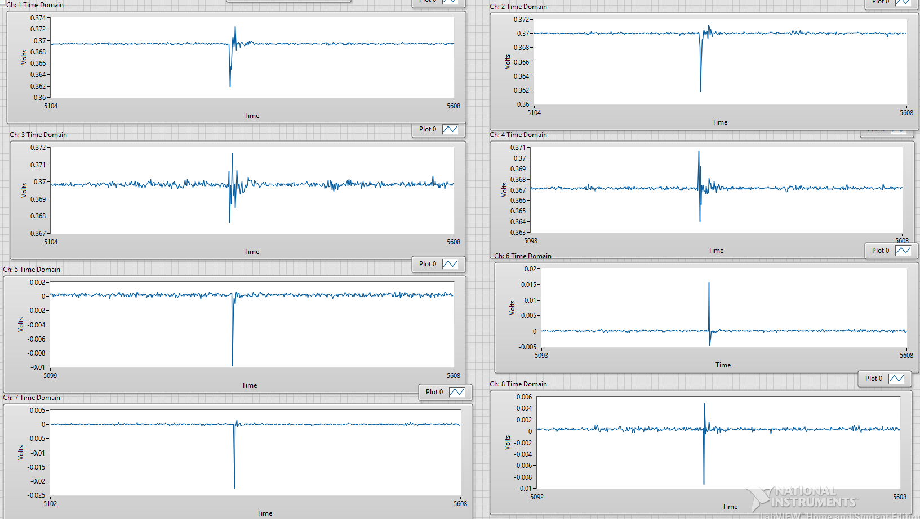
8 channel TD no buffer

Slide 11
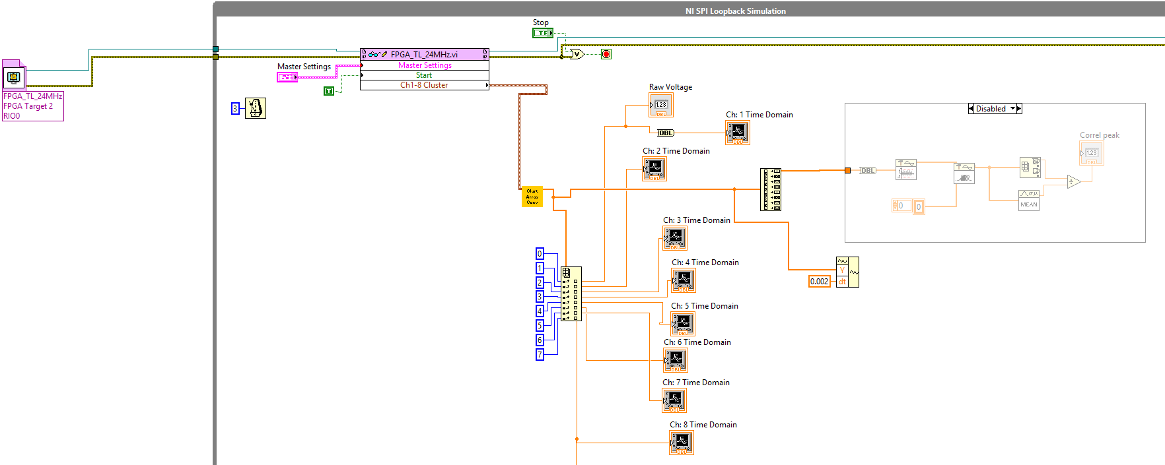
8 Channel Block Diagram

Slide 12
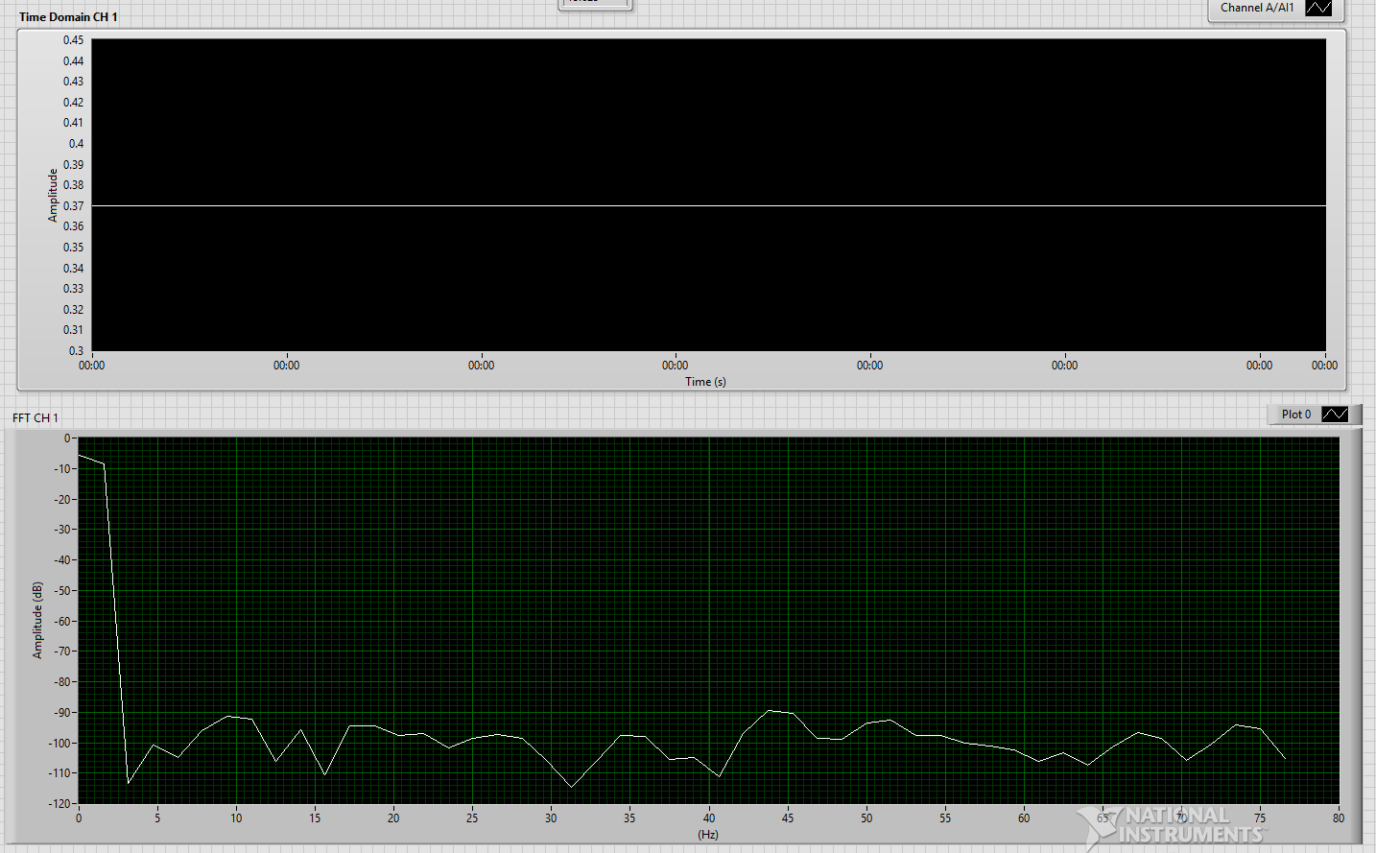
Waveform no buffer (no excitation)

Slide 13
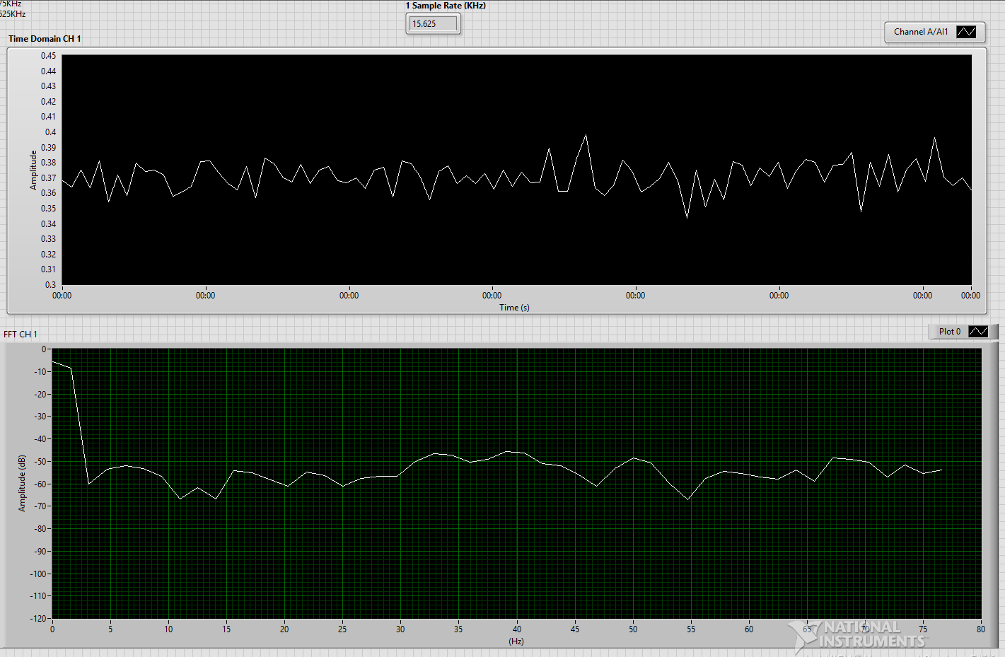
Waveform no buffer (with excitation)

Slide 14
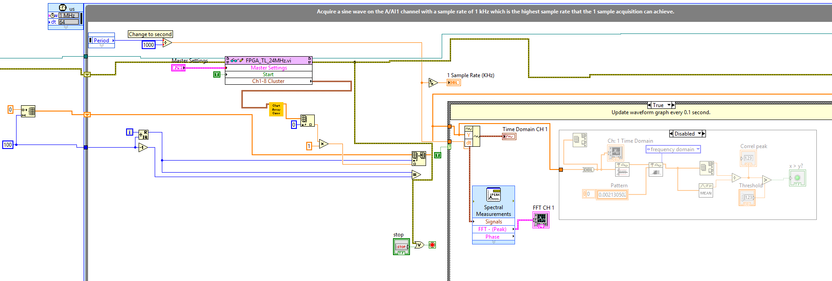
Build WF Block Diagram

Slide 15
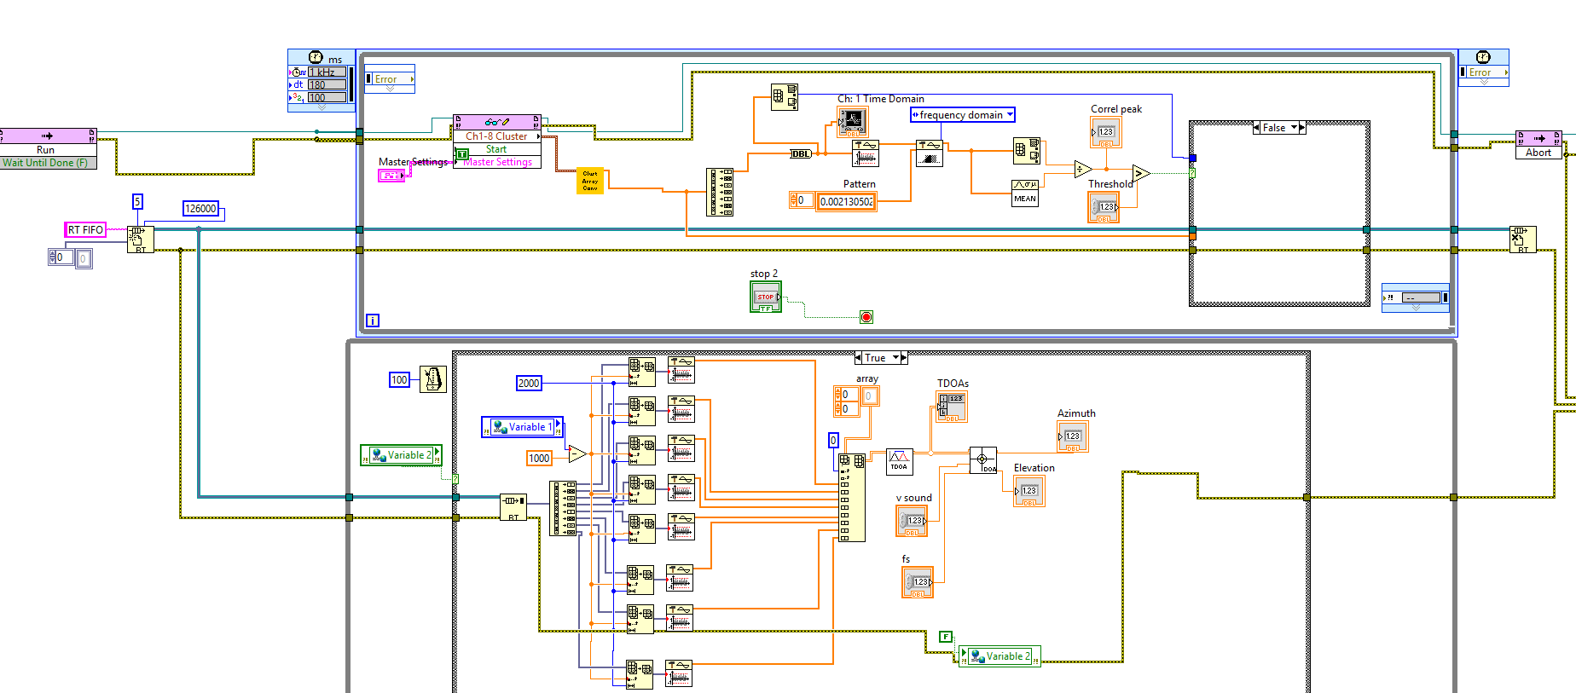
Modified IME Process

Slide 16
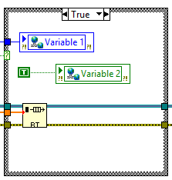
IME Process True Case

Slide 17
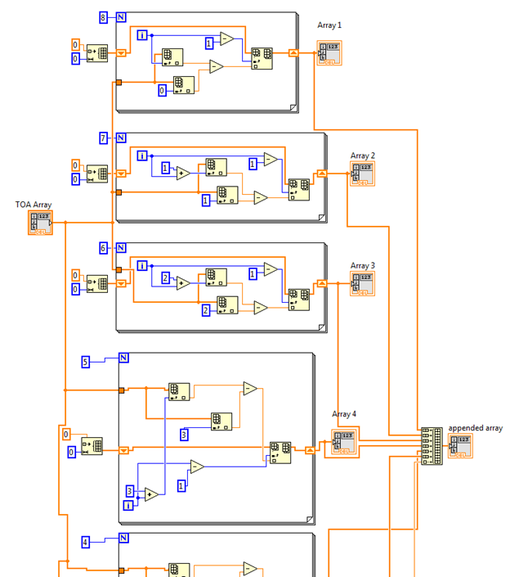
Tau Vector Calculator

Slide 18
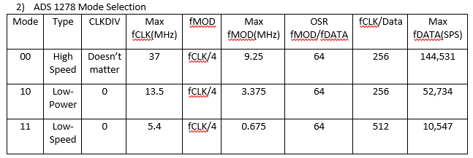
Mode Selection

Slide 19
ADC notes
1) Format:
TDM Fixed: 001
Discrete: 010
2) Misc:
Leading Clock Phase,
Clock Polarity – Low,
Most Significant bit First
Output in 24 bit two’s complement

Slide 20
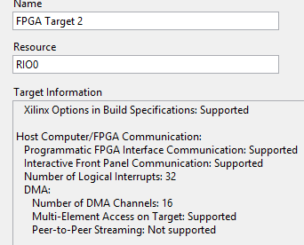
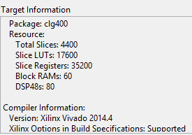
FPGA MyRIO Properties

Slide 21
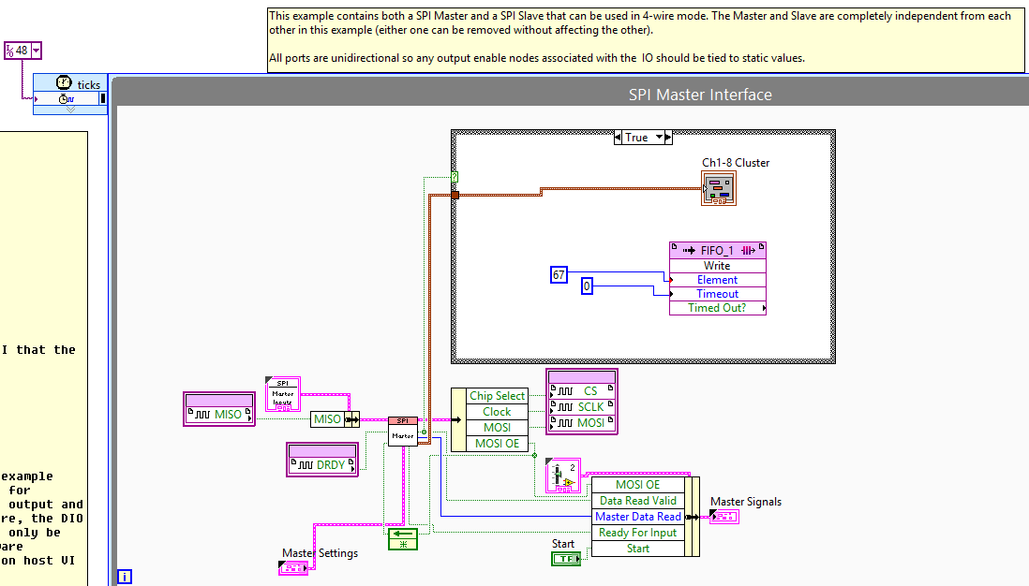

Slide 22
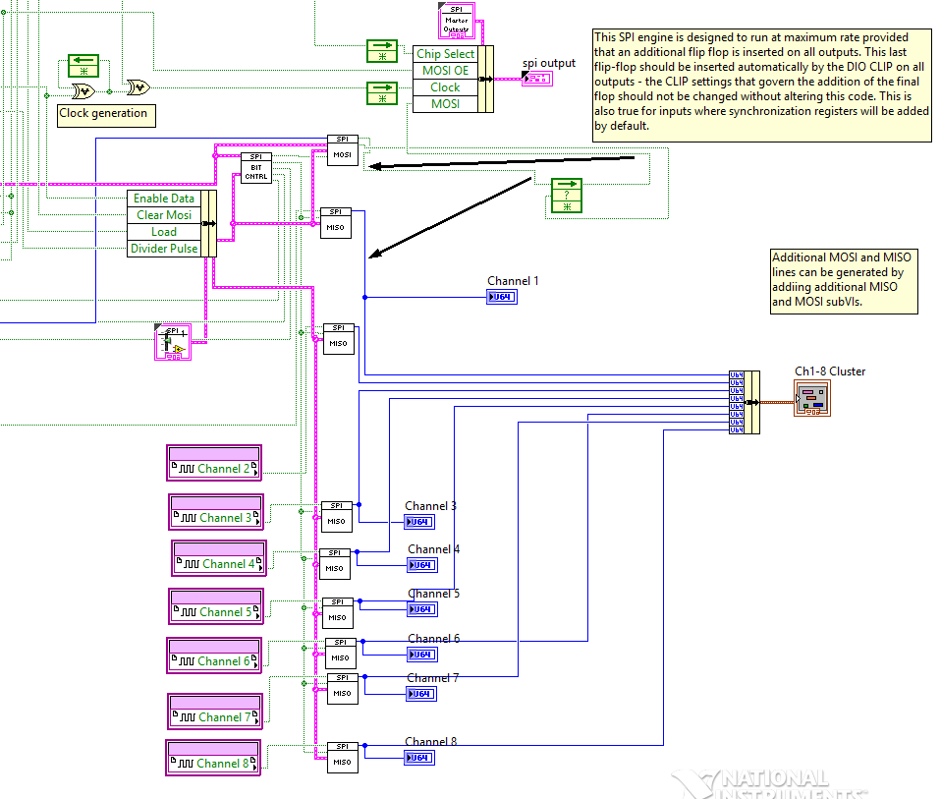

Slide 23
Writing audio to wav MYRIO
Youtube - NI
Arduino Project
Minor Help
LV
Makerhub
Very helpful

Slide 24
Misc Links
Sound Isolation
ARDrone with LV
HighThrough
Xilinx FIR Filter

Slide 25
LV Kalman Filter Links
1
LavaGcode
Print
Paper
Research
NI White Paper
NI Demo
Same?
NI Disc. Kalman
NI Cont. Kalman

Slide 26
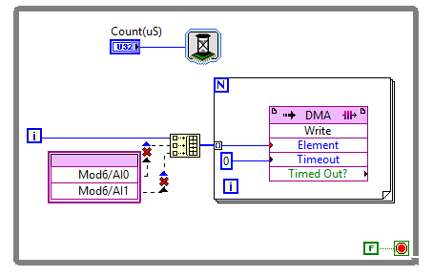
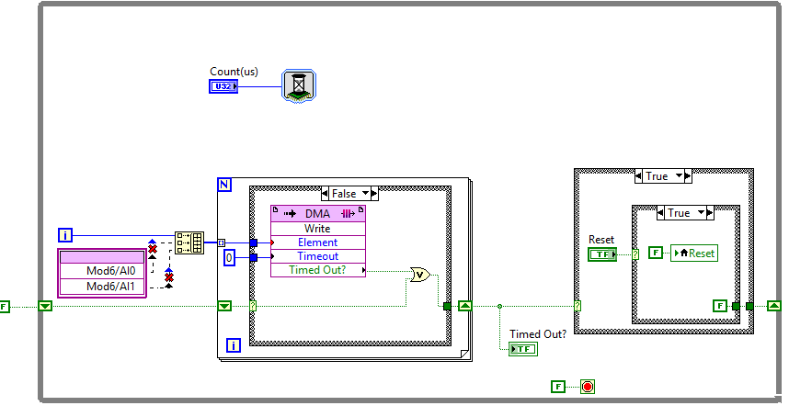
Examples from NI - FPGA DMA
Bad Good

Slide 27
Examples from NI - RT DMA Bad

Slide 28
Examples from NI - RT DMA Good

Slide 29
Using Desktop Execution for FPGA
http://www.ni.com/white-paper/51859/en/
http://www.ni.com/tutorial/51862/en/

Slide 30
More FPGA
You should also consider doing the PID inside of the FPGA. PIDs work the best in a deterministic environment, and you can't get any more deterministic than on an FPGA.
SCTL: https://knowledge.ni.com/KnowledgeArticleDetails?id=kA00Z000000P8sWSAS
Can I use pipelining to allow more logic to execute inside the SCTL?
Yes. You can use shift registers or feedback nodes to allow logic to execute in parallel and pass data between subsequent iterations of the SCTL; thus, the entire logic chain executes over multiple SCTL iterations. As with any parallel implementation in an FPGA VI, this uses additional FPGA resources.
Also make sure that your timeout for writing to the FIFO is set to 0. Because the code MUST execute in a single cycle, it cannot wait.

Slide 31
To Do:
Clean Up FPGA data types
Clean up DMA FIFO
Figure out how to do Desktop execution of FPGA
Setup proper Configure for start of myrio, FPGA, and DMA
Need to use High Throughput
Install FPGA Floating Point Library
Look at waveform examples (Align Waveform Timestamps)

Slide 32
FXP vs FLP
While FPGAs can implement floating point numerical operations in general-purpose logic slices, this consumes significant resources and limits the amount and complexity of the realizable signal processing. Instead, it is common to use fixed-point representations which allow fractional data, but do not require the additional resources of a floating point representation.
Deciding
Using FXP on FPGA

