Slide 1
LV Source Localization
Resources
By: Kory Olney

Slide 2
To Do:
Look into Handshaking Target Scope to DMA Implementation from SCTL to embedded For Loop
Optimize FPGA Data Types
And Decide w
Servos
Clean up/test RT Algorithm
Complete this list…
Developers Guide ***
CRIO Dev Guide
The Engineer’s Guide to Signal Conditioning
FPGA High Performance Guide

Slide 3
Good Examples
Communicating with an ADC via an NI 6587 FlexRIO Adapter Module
R Series Application - Onboard Signal Processing

Slide 4
Download toolkit

Slide 5
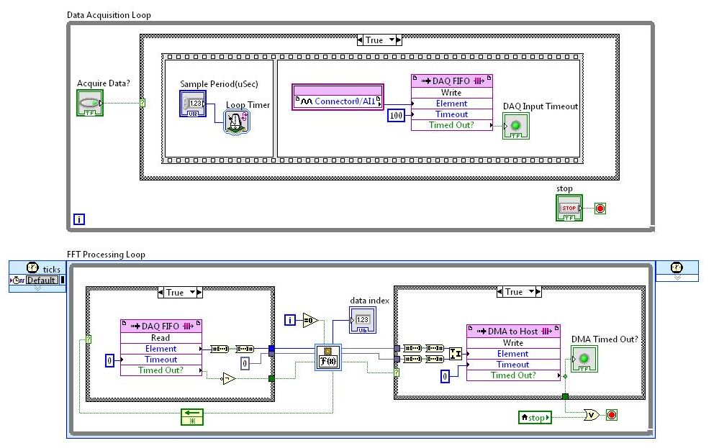
Example - Implementing Inline FFT Processing

Slide 6
Transferring Data From FPGA to Host
DMA FIFO from transferring data between the FPGA and RT
Transferring Data between the FPGA and Host (FPGA Module)
Transferring Data between Devices or Structures Using FIFOs (FPGA Module)
Configure FIFO Name Control Type Dialog Box

Slide 7
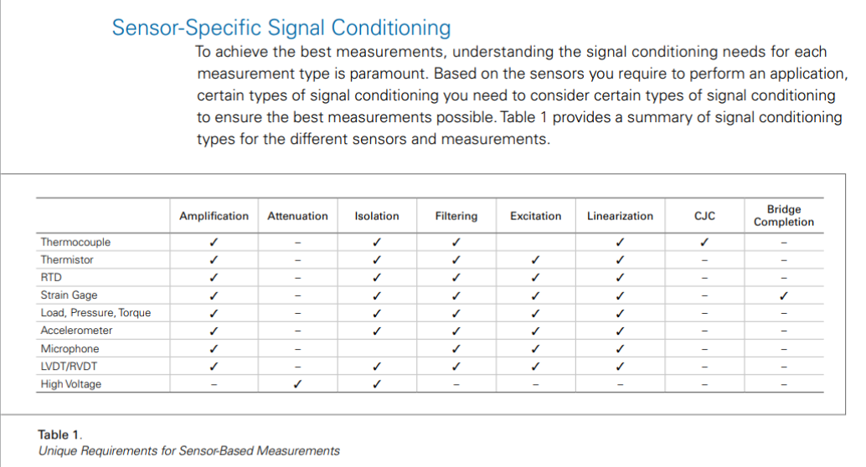

Slide 8
DMA Handshaking
This interface is available only within a single-cycle Timed Loop for FIFOs that invoke Read or Write methods. Additionally, some targets do not support the handshaking interface for peer-to-peer and DMA FIFOs. LabVIEW returns a compile time error for FIFOs that do not support the handshaking interface.

Slide 9
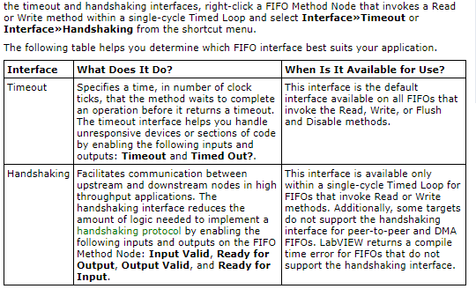
FIFO
Use FIFOs to transfer data in the following ways:
Between parallel loops within one clock domain
Across clock domains
Between peer-to-peer targets
Between the host computer and the FPGA
Choosing between the FIFO Interface Options (FPGA Module)

Slide 10
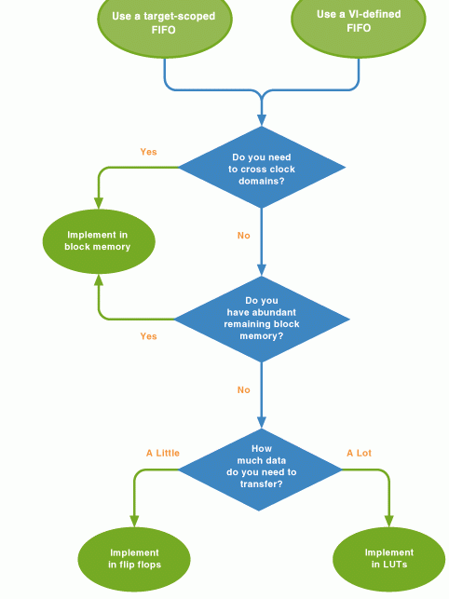
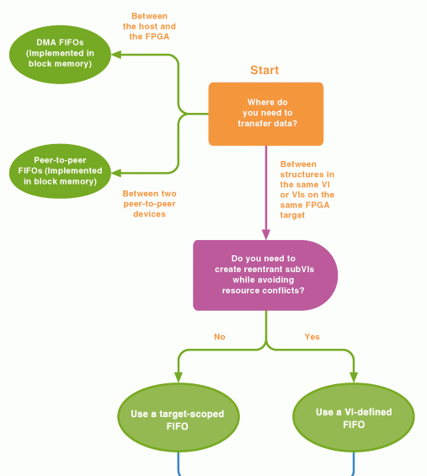
Choosing FIFO

Slide 11
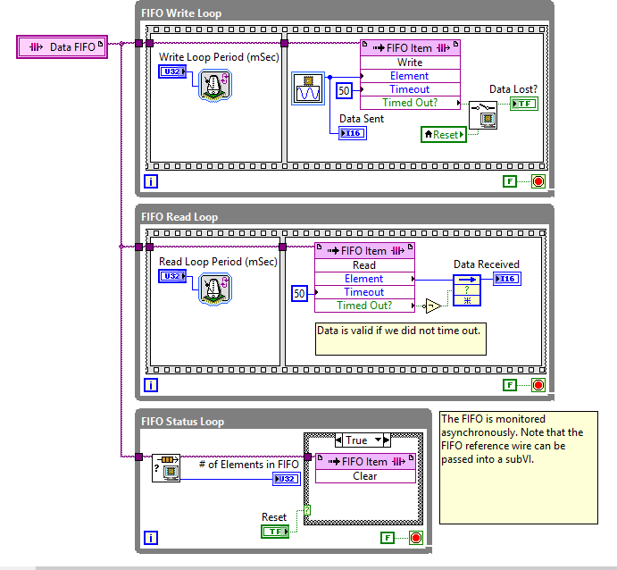
VI-Defined FIFO
From VI Defined FIFO Example Project
VI-defined FIFOs— Use VI–defined FIFOs along with FIFO name controls to create reentrant subVIs and avoid resource conflicts. If you configure a VI-defined FIFO in a reentrant FPGA VI, LabVIEW creates a separate copy of the FIFO for each instance of the VI.

Slide 12
Target Scoped FIFO - use for loop transfer_ Block memory
Target-scoped FIFOs—Use target-scoped FIFOs if you want the FIFO to be visible and configurable from the Project Explorer window. Target-scoped FIFOs have a corresponding item in the project. Updates to the project item affect all instances of the FIFO. Target-scoped FIFOs are accessible within any VI under the same FPGA target in the Project Explorer window. If you use a target-scoped FIFO and want to send the FPGA VI to another user, you have to send the entire project. Otherwise, the FPGA VI is broken.

Slide 13
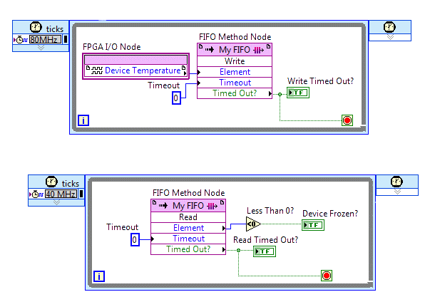
Transfer Data Between FPGA Loops - Target Scope

Slide 14
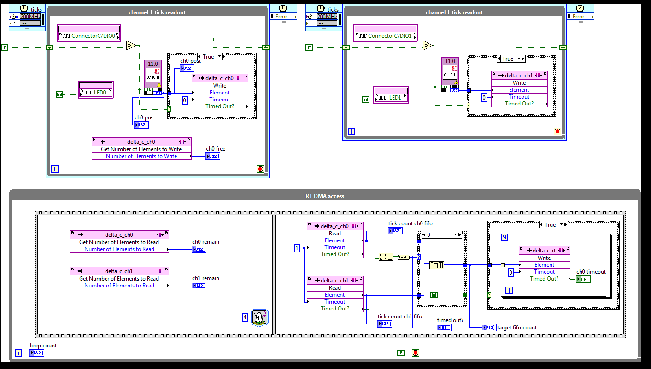
Target-scoped FIFO

Slide 15
DMA Notes
(1 of 2) If you experience timeouts during DMA transfers from the FPGA to a host, use the FIFO.Configure method of the Invoke Method function and increase the Depth parameter rather than increasing the Requested Number of Elements. Increasing the Depth parameter increases the size of the host-side buffer, which is more likely to resolve the timeout and does not increase FPGA device utilization.

Slide 16
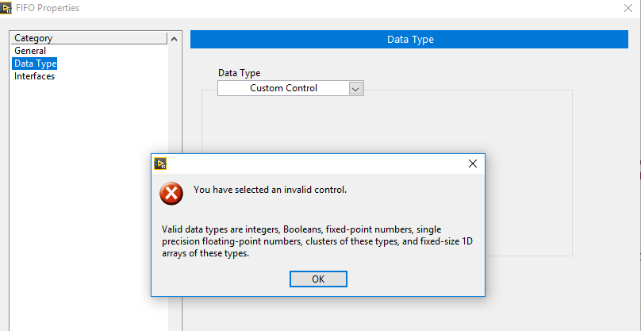
Creating Custom Control For Tscope FIFO

Slide 17
DMA FIFO
Between the host and the FPGA—Use direct memory access (DMA) FIFOs to transfer large amounts of data between the host and the FPGA. This type of FIFO directly accesses memory to transfer data from FPGA target VIs to host VIs and vice versa. A DMA FIFO allocates memory on both the host computer and the FPGA target, yet acts as a single FIFO. DMA FIFOs provide performance advantages over using front panel controls and indicators to communicate between the host and the FPGA.
With that said, the FIFOs behave basically the same independent of what target they are used on, with one big exception. On FPGA targets if the FIFO gets full the new data will not overwrite the old data and the new data will be lost. On other targets the FIFO write function includes a boolean that allows the new data to overwrite old data if the FIFO is full.
configuring the FIFO depth (i.e. length) to be the same as the size of block of data that you want to read. With no extra "wiggle" space that could cause problems too. I'd recommend that if you have the memory capability to configure the FIFO depth to hold 2 full blocks of data.

Slide 18
Clearing FPGA FIFO
When you run the FPGA VI on a development computer with real I/O, LabVIEW clears FIFOs when the FPGA VI stops and then starts again. When you run the FPGA VI on an FPGA target using interactive front panel communication, LabVIEW does not clear FIFOs when the FPGA VI stops and then starts again. To clear target-scoped or VI-defined FIFOs on the FPGA, use the Clear method of the FIFO Method Node. You also can right-click the VI in the Project Explorer window and select Download from the shortcut menu to clear FIFOs.
When you control an FPGA VI using programmatic FPGA interface communication, use the Stop method of the Invoke Method function to clear individual DMA FIFOs from the host VI. You also can clear all FIFOs using the Reset method on the Invoke Method function or the Close FPGA VI Reference function with the Close and Reset if Last Reference shortcut menu option selected. In addition to clearing FIFOs, the Reset method and Close and Reset if Last Reference option complete other tasks.

Slide 19
FIFO Implementation
Note If the FIFO Method Node contains a Timeout input parameter, you must wire a constant of zero to the parameter when the node is in a single-cycle Timed Loop.
Creating FIFOs in FPGA VIs (FPGA Module)

Slide 20
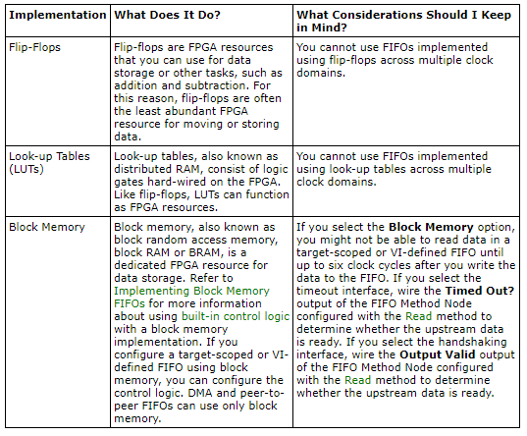
Memory Options

Slide 21
NI CompactRIO Waveform Reference Library
You will likely need to move this example to another FPGA target and then use a "save as" on all VIs to avoid editing the source install. For more information refer to ni.com/info and enter info code fpgaex.
The Host Examples section demonstrate various flavors of continuous and finite acquisition.
The FPGA Templates section has one template for Delta Sigma based modules and one template for SAR based modules. Under the FPGA target you will also find the DMA Channel, and a PDF document describing how to customize the FPGA VIs for your hardware configuration.
National Instruments\LabVIEW [Version]\ProjectTemplates\Source\cRIOWfm

Slide 22
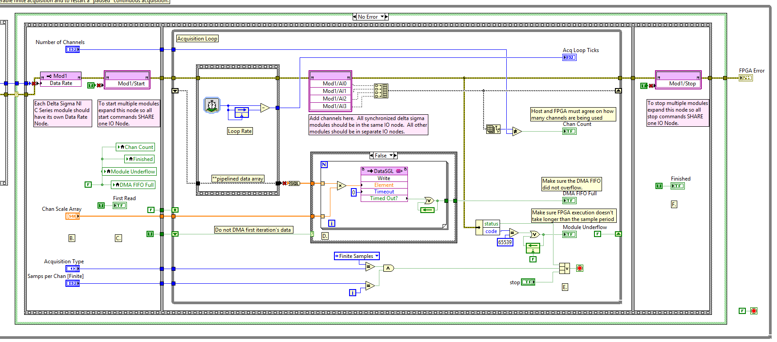
CRIO WFM REF

Slide 24
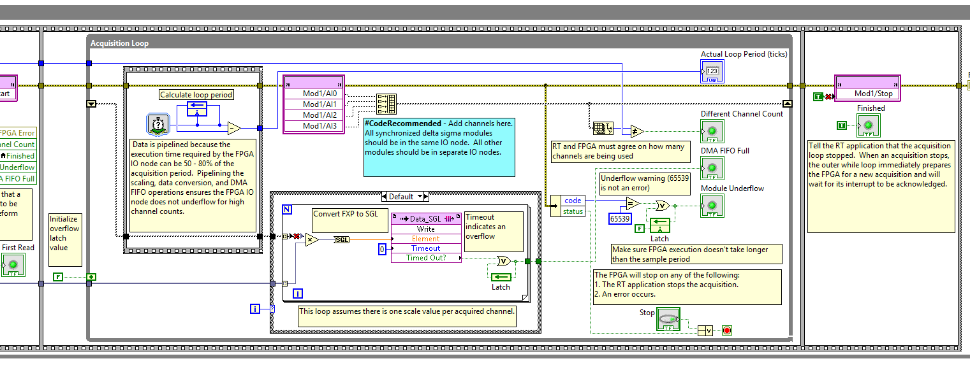

Slide 25
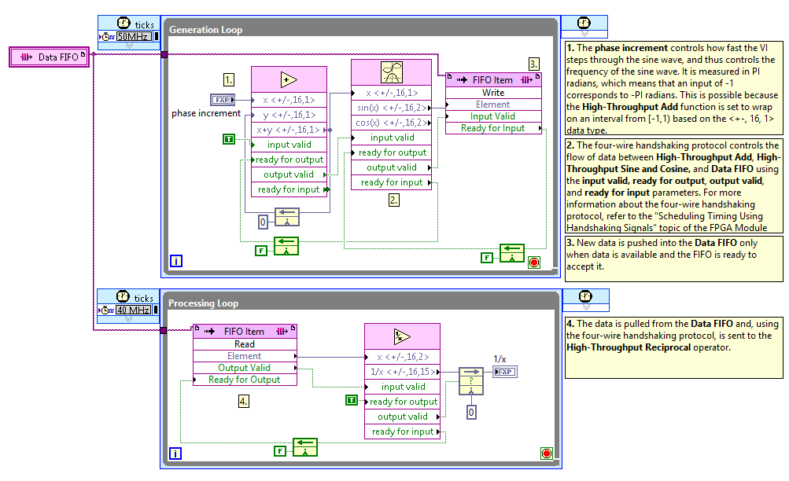
FIFO With Handshaking

Slide 26
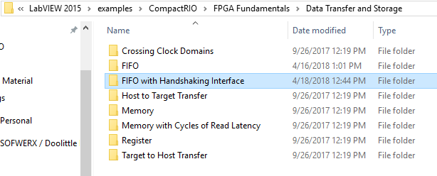

Slide 27
Relevant Examples

Slide 28
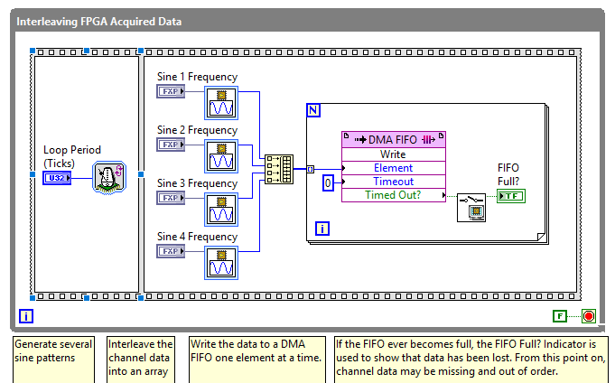
Interleaving Channels DMA FPGA

Slide 29
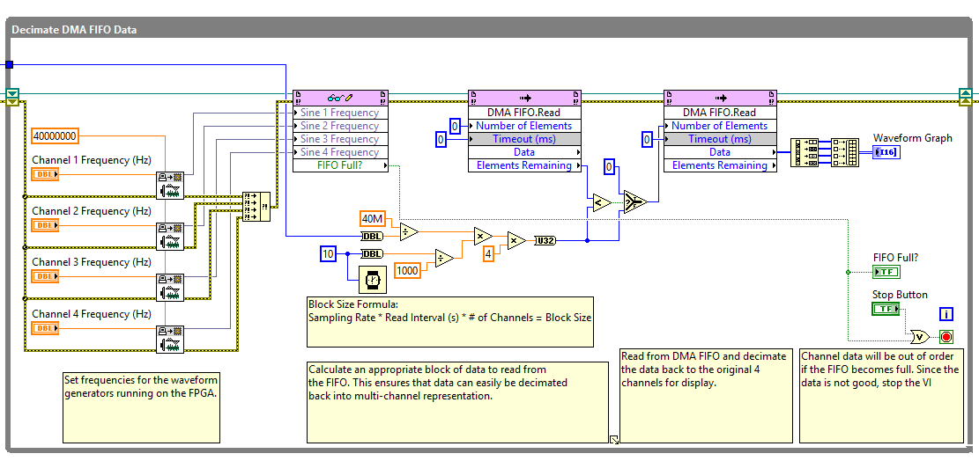
Interleaving Channels DMA UI

Slide 30
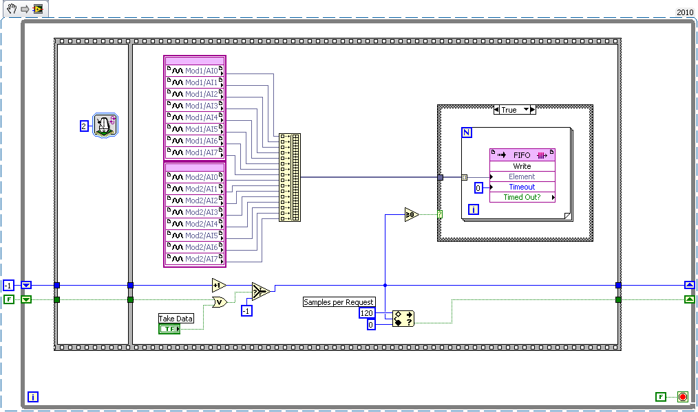

Slide 31
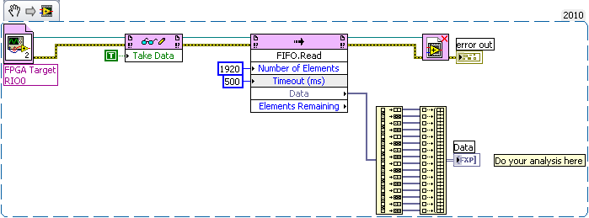

Slide 32
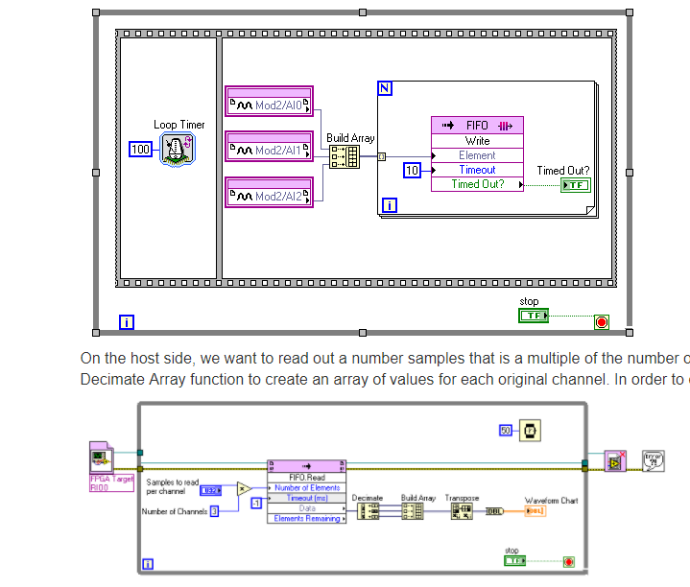
Transfer multiple channels of data through one DMA FIFO on FPGA
ces

Slide 33
Polymorphic Interpolation Xilinx**

Slide 34
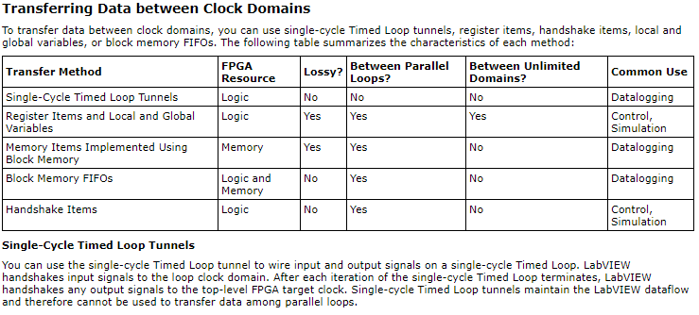
Implementing Multiple Clock Domains (FPGA Module)

Slide 35
Reference Example for Streaming Data from FPGA to cRIO to Windows

Slide 36
DMA FIFO from transferring

Slide 37
Using Fixed-Point Data with CompactRIO and LabVIEW FPGA
Fixed-Point Data Over DMA FIFO

Slide 38
FXP to u32

Slide 39
CRIO Save to Memory

Slide 40
Scheduling Timing Using Handshaking Signals (FPGA Module)

Slide 41
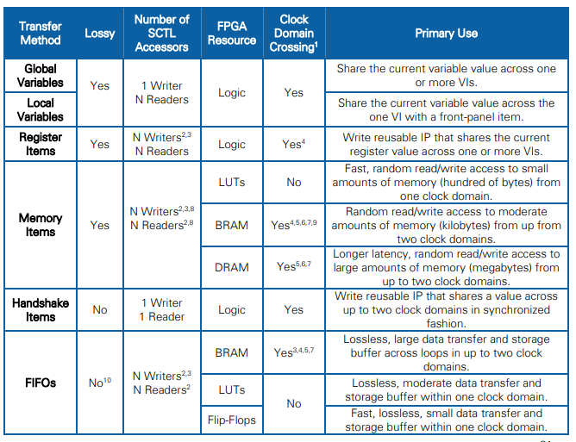

Slide 42
Transferring Data between the FPGA and Host (FPGA Module)
Transferring Data between Devices or Structures Using FIFOs (FPGA Module)
Transferring Data between Devices or Structures Using FIFOs (FPGA Module)

