Slide 1
DAQ PCB Design
Kory

Slide 2
Goals
Develop a Data Acquisition Board (DAQ) using the ADS1278 ADC and the THS452X op-amps that will condition and sample 8 analog channels synchronously.
The board will connect directly to the myRIO through a 32 pin MXP providing all of the necessary power and data transmission lines. (SPI, SCLK, etc.)
The board will be designed as a multipurpose precision DAQ that can sample up to 151 ksps of 24 bit data.
The board will provide some modularity where AA filters may be disabled and potentially a PGA could be on board providing user selection

Slide 3
To DO
Find out if BatchPCB populates boards or go with a local manufacturer
Decide differential approach or single ended.
Finalize Schematic and simulate in TINA-Spice

Slide 4
Important Links
Forum e2e Post ***
ADS1278 Data Sheet
EVM ADS1278 User Manual
THS452X Amp Data Sheet
THS452X EVM Manual
ADS127L01 24-Bit, High-Speed, Datasheet

Slide 5
More Design Links
https://e2e.ti.com/support/amplifiers/high_speed_amplifiers/f/10/t/631113?tisearch=e2e-sitesearch&keymatch=ths4521
https://e2e.ti.com/support/amplifiers/high_speed_amplifiers/f/10/t/669153?tisearch=e2e-sitesearch&keymatch=ths4521%20ads1278
ECG reference Design
Analog Engineer’s Pocket Reference**
TI Precision Labs Lecture Manual**
Precision Labs **

Slide 6
More Resources
delta-sigma ADC basics
Data Converters – Learning center**
Understanding input range requirements for Precision ADCs with integrated PGAs
Delta-sigma-advantage-to-anti-aliasing-filters
Benefits of Delta-Sigma Analog-to-Digital Conversion

Slide 7
Ref. Projects with Schematics
ADS1278 EVM
Electret Pre-amp
THS452X EVM
ADS127L01 Delta-Sigma ADC
Quad-Channel 250-Msps Digitizer with Variable Gain Amplifier Reference Design
-Low Power, Low Noise 24b Analog Front-End
8-ch Isolated High Voltage Analog Input Module
High Accuracy Analog Front End Using 16-Bit SAR

Slide 8
TI Reference Design
Video
elecret amp board
http://www.ti.com/tool/ads127l01evm
DigiKey Ref Design

Slide 9
Voltage Regulator
TI Reference Designs
TI's List
http://www.ti.com/power-management/reference-designs.html
https://www.baldengineer.com/regulator-basics.html
Popular LDO
SC LDO
Need 1.8V and 4.5uA, max 5.1 on plugin
ch1,

Slide 10
Potential Components
LDO, Report (Low-noise Power)
Pre-amplifiers
Audio Op-Amps and references**
Step Down Converter
Electret Microphone Amplifier - MAX9814 with Auto Gain Control
SparkFun Electret Microphone Breakout
SparkFun MEMS Microphone Breakout - INMP401 (ADMP401)

Slide 11
Potential Eval Hardware
TI Precision Amplifier Quickstart Kit
TI Precision Labs - Op Amps Evaluation Module
THS4521EVM
User Guide
DataSheet
MEMS Mic > ECM

Slide 12
Scratch Notes
Should I include a PGA?
Check out this reference design that includes AA-filters(More links in TI notes slide)**
Single supply or dual?
Analog Engineer’s Pocket Reference
ADS1x7x Excel™ Calculator Tool
TI DelSigma
Data Converters – Learning center
TI Precision Labs

Slide 13
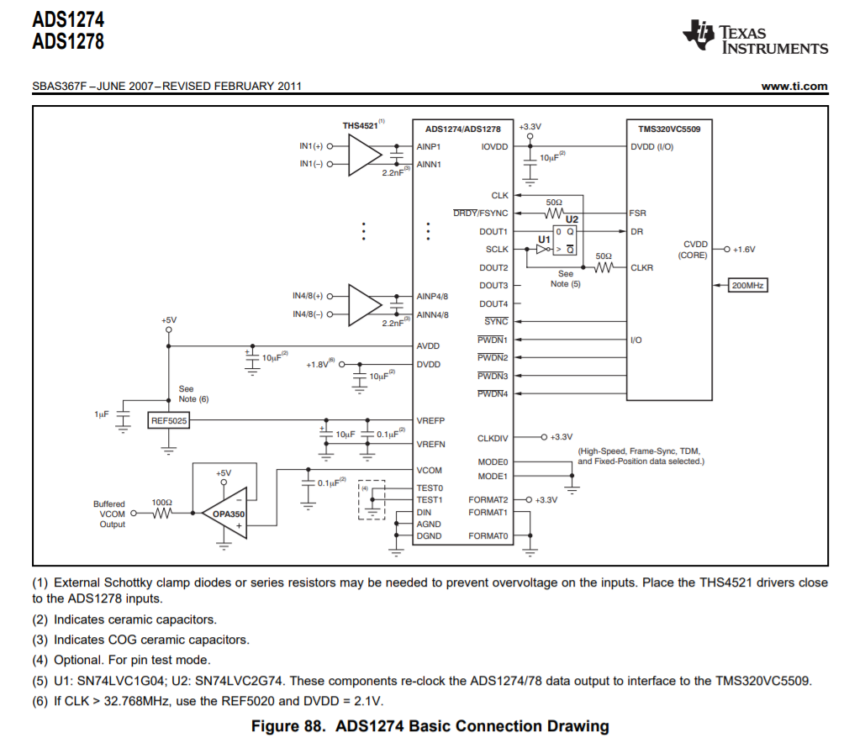

Slide 14
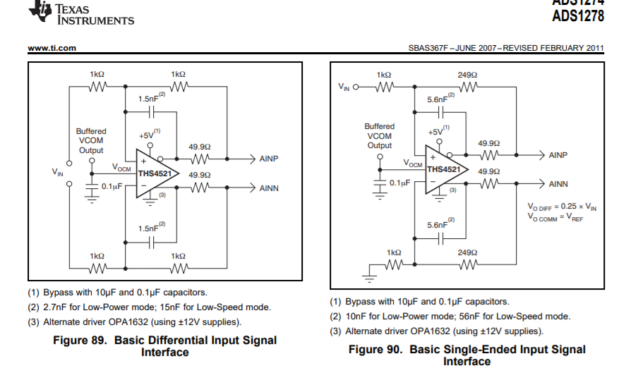

Slide 15
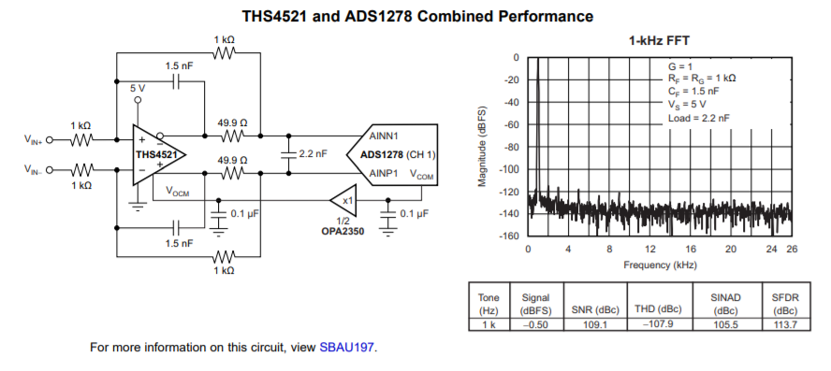

Slide 16
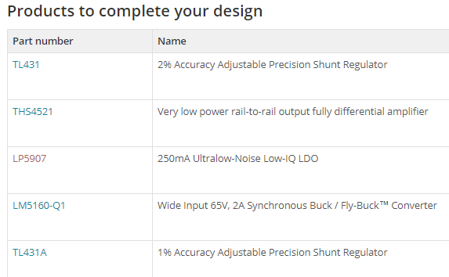
Companion to ADS1278
THS4521
LP5907
TL431A

Slide 17
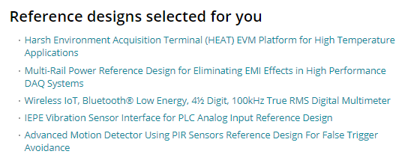
From ADS1278

Slide 18
Where to order PCB?
https://oshpark.com/(BatchPCB)
-https://dorkbotpdx.org/wiki/pcb_order
https://dirtypcbs.com/store/pcbs
http://www.4pcb.com/
https://www.expresspcb.com/
http://www.sunstone.com/pcb-products/assembly-services Oregon
These high quality boards do not include the silkscreen or solder mask layers.

Slide 19
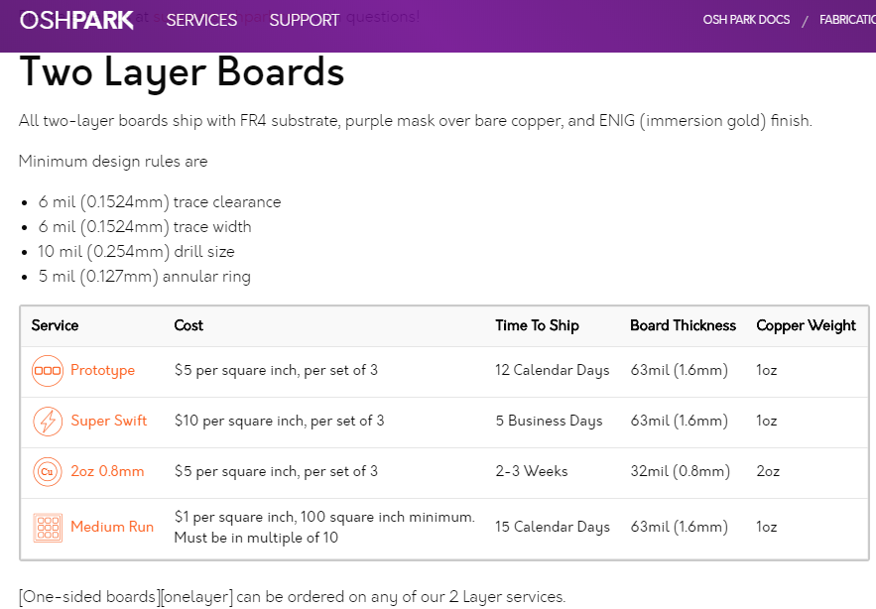
2 oz is thinner and lighter

Slide 20
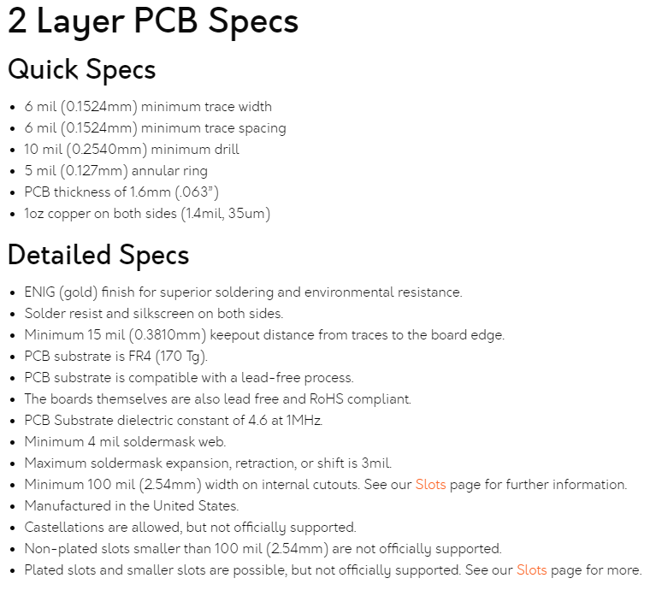
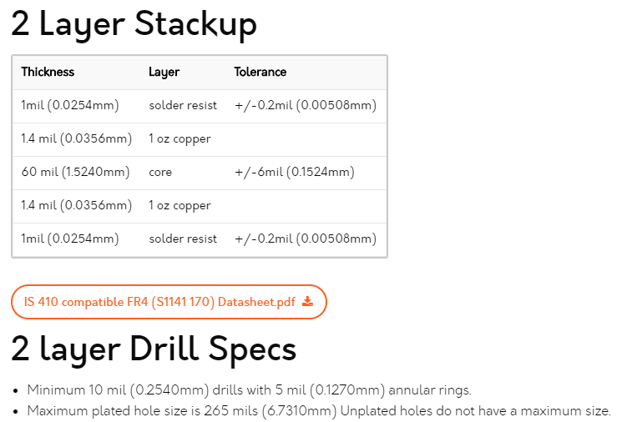

Slide 21
Chinese Manu.
https://www.pcbcart.com/
https://www.pcbgogo.com/
https://www.pcbway.com/

Slide 22
Notes from TI guides etc
2.5 Layout Considerations Board layout is critical for high-speed circuits. To achieve a proper layout, TI recommends the following: • The amplifier and ADC should be located as close together as possible to reduce effects of impedance mismatch and minimize inductance. • Both the amplifier and the ADC require that the filter components be located in close proximity. • The ADC digital outputs must be well isolated from the ADC input as well as from the amplifier inputs. • The amplifier input and output pins should not be placed over power or ground planes to reduce parasitic capacitance for stability reasons. • Power-supply bypass capacitors should be low ESR and placed within 2 mm of the associated pins. • When vias are used, using multiple vias is recommended. This includes placing ground vias near vias on the signal traces. source**, datasheet

Slide 23
Notes from TI guides etc
Spurious-free dynamic range (SFDR) is the strength ratio of the fundamental signal to the strongest spurious signal in the output. It is also defined as a measure used to specify analog-to-digital and digital-to-analog converters (ADCs and DACs, respectively) and radio receivers.
SFDR is defined as the ratio of the RMS value of the carrier wave (maximum signal component) at the input of the ADC or output of DAC to the RMS value of the next largest noise or harmonic distortion component (which is referred to as a “spurious” or a “spur”) at its output. SFDR is usually measured in dBc (i.e. with respect to the carrier signal amplitude) or in dBFS (i.e. with respect to the ADC's full-scale range). Depending on the test condition, SFDR is observed within a pre-defined frequency window or from DC up to Nyquist frequency of the converter (ADC or DAC)
brief review of op-amps

Slide 24
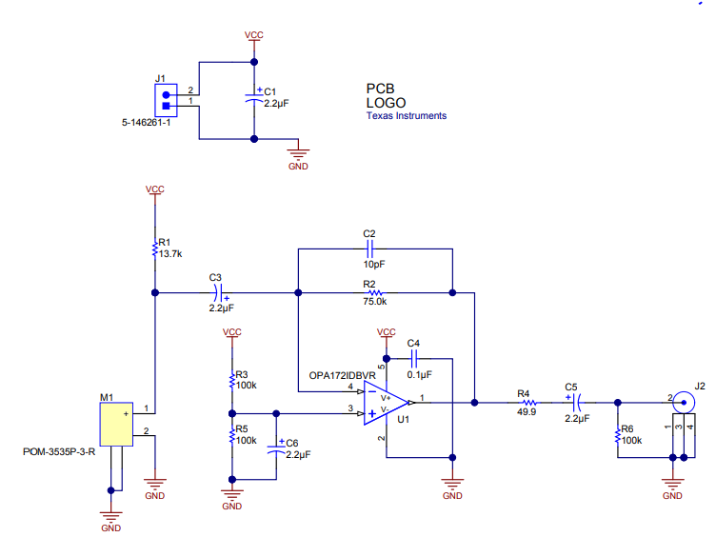
Elec Mic EX

Slide 25
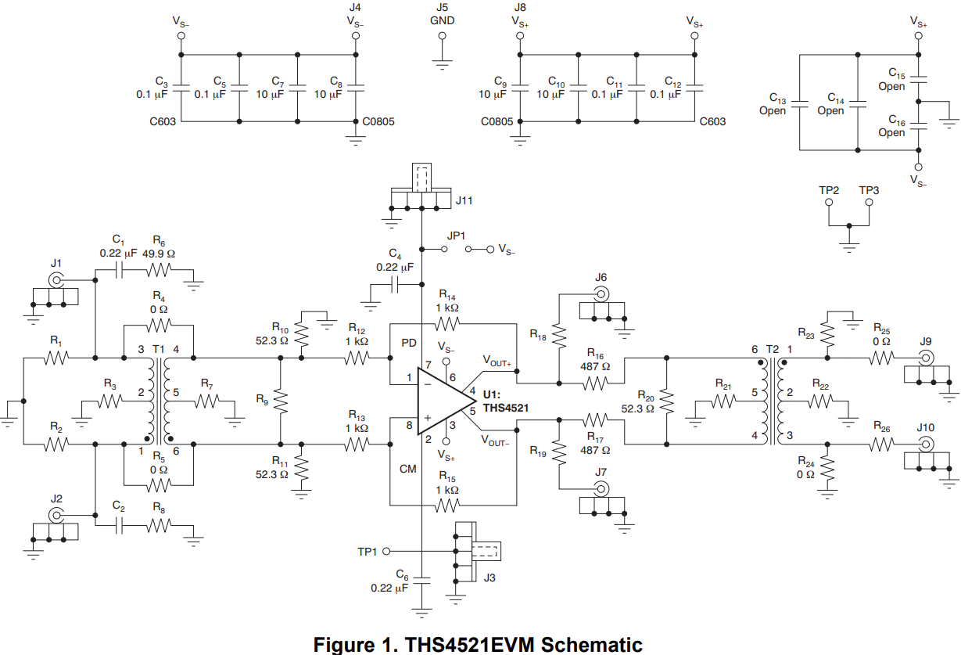

Slide 26
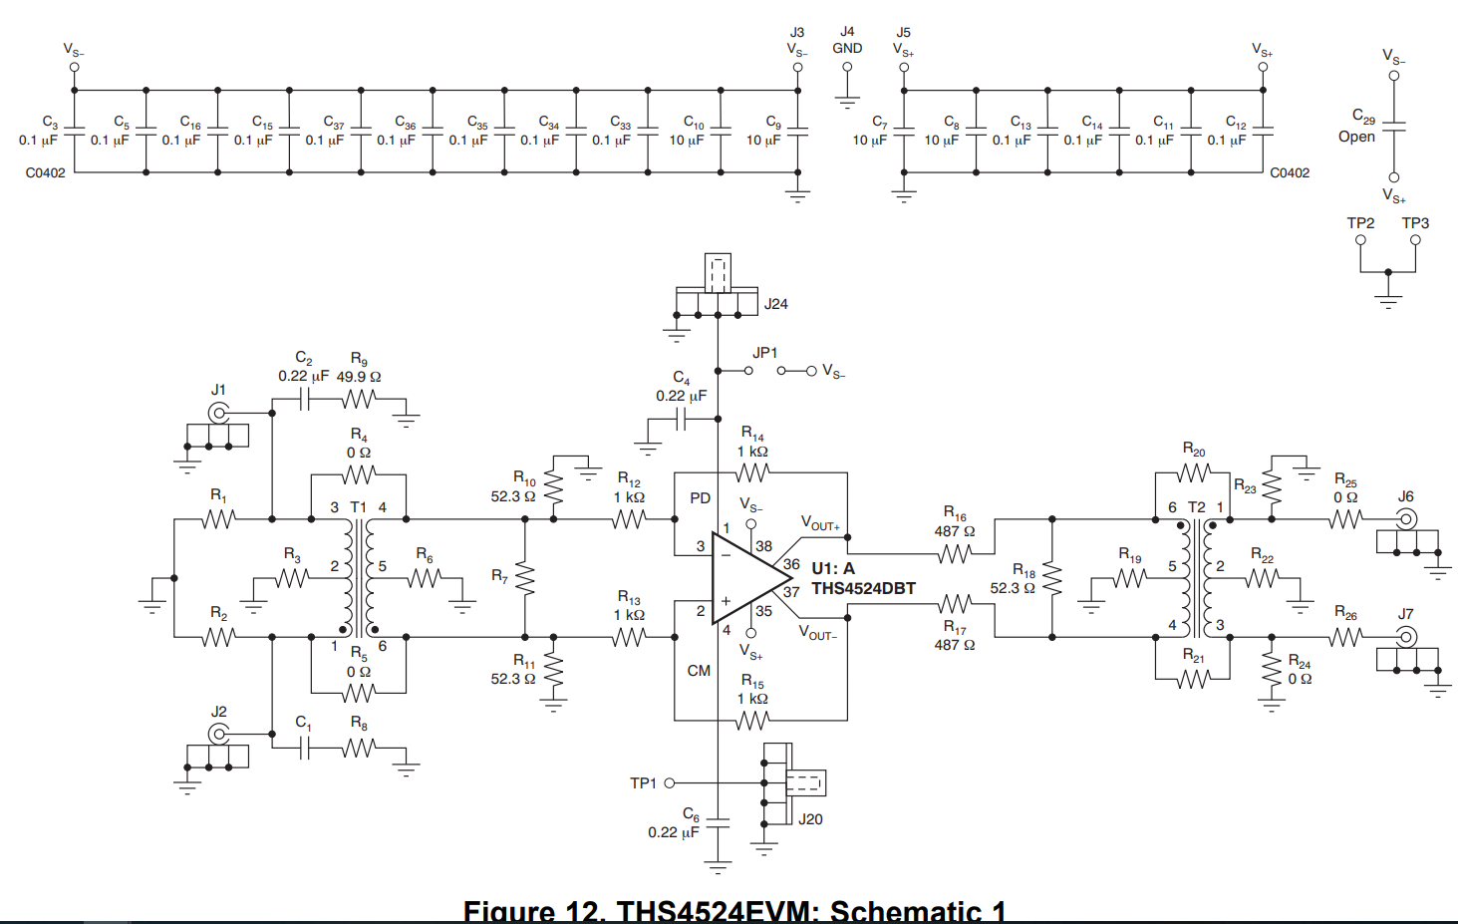

Slide 27
Elec Mic EX

Slide 28
Design Software
Downloaded Eagle and Circuit Maker, I will first be looking at designing in CM
Also could do ExpressSchematic and ExpressPCB
TI Filter Designer

Slide 29
Circuit Maker Introduction Links
https://documentation.circuitmaker.com/ Top Level
https://circuitmaker.com/forum/posts/220414
http://documentation.circuitmaker.com/display/CMAK/From+Idea+to+Manufacture+-+Driving+a+PCB+Design+through+CircuitMaker
http://documentation.circuitmaker.com/display/CMAK/Exploring+CircuitMaker
Youtube Intro
Video Gallery

Slide 30
Notes From TI Blog Post
your AAF should attenuate the noise seen after the first Nyquist frequency to a level which is insignificant when compared to the ADC's inherent quantization and thermal noise
For a SAR, this attenuation level must be reached very close to Nyquist. However, for a delta-sigma ADC, this attenuation is really necessary closer to the modulator sampling frequency (fMOD). Between the data rate Nyquist frequency (fDATA / 2) and fMOD, the digital filter stopband will suppress most of the out-of-band noise.
The signal bandwidth of interest determines the passband that you need for your filters (AAF and digital). The difference in frequency between the signal bandwidth and the aliasing band determines the type of AAF and the response you need. Ideally, your AAF and digital filter should remain relatively flat throughout your bandwidth of interest. For low-speed applications where the bandwidth is only a few hundred hertz, a first- or second-order RC filter may be enough since the modulator of the ADC is often running at frequencies greater than hundreds of kilohertz. Conversely, a high-speed application with hundreds of kilohertz of signal bandwidth may need a high-order active filter to reach the attenuation target before a modulator frequency of a few megahertz.

Slide 31
https://www.planetanalog.com/document.asp?doc_id=532470&site=planetanalog
Delta-sigma ADC signal chain
The signal chain for the delta-sigma converter application starts with the sensor (left side of Figure 1). Contrary to a typical SAR-ADC system, there are no analog gain circuits, such as an amplifier and instrumentation amplifier, following the sensor block. Between the sensor and the delta-sigma converter, there is an anti-aliasing, low-pass filter. The delta-sigma converter and the SAR-ADC anti-aliasing filter designs are significantly different. With a SAR converter, the anti-aliasing filter usually has an active fourth to eighth order implementation, requiring two to four amplifiers. As Figure 1 shows, the delta-sigma anti-aliasing implementation generally requires only a first order, passive filter _{[1]}.
With the digital filter in place, the requirements placed on the anti-aliasing filter become even more relaxed! Instead of needing to filter everything beyond the Nyquist frequency as in SAR ADCs, the anti-aliasing filter for delta-sigma ADCs only needs filter out unwanted frequency content around multiples of fMOD. This allows for an even more gradual filter roll-off that is much easier to design with a few discrete, passive components. Typically, a single-pole RC filter is all that is required, but you may need a second-order filter for lower OSRs.

Slide 32
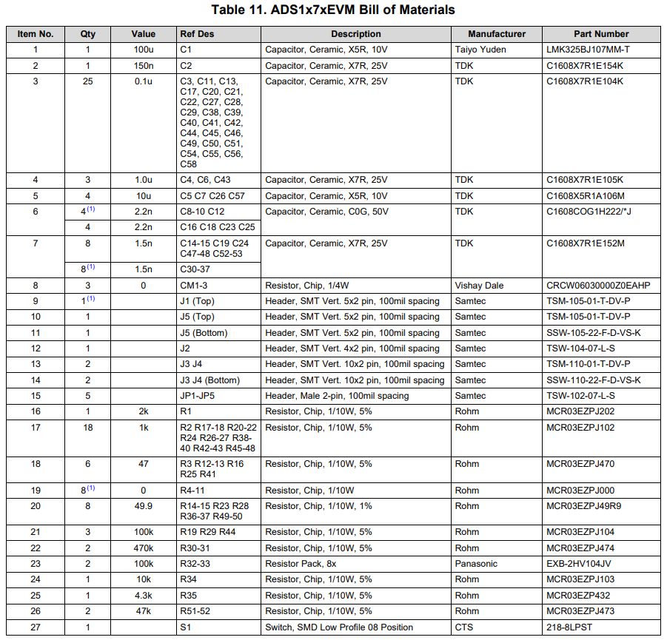
Ads1278 BOM

Slide 33
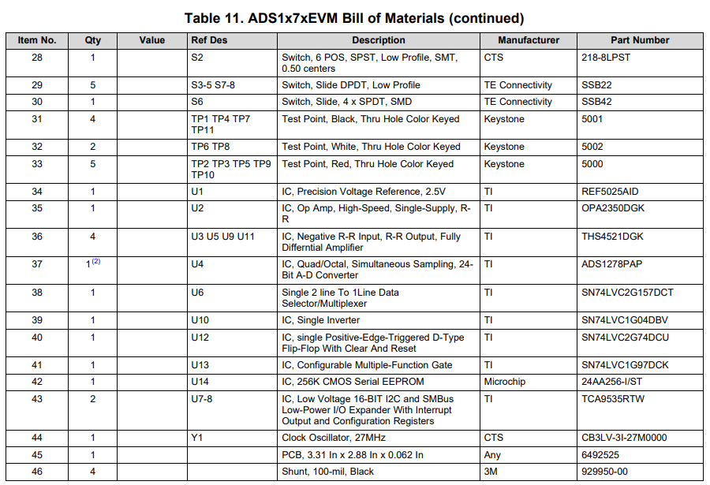
Ads1278 BOM

Slide 34
TI Filter Designer
Resources - Videos

Slide 35
Hardware/Connectors
DIN 41651 PCB connectors (MXP is 0.1”)
https://store.digilentinc.com/mxp-extender-cable-for-myrio/
https://www.digikey.com/product-detail/en/te-connectivity-amp-connectors/1-215307-7/A121775-ND/2278494
Soldering SMA
Female PCB SMA
Cable
Male Connectors
SparkFun MEMS Microphone Breakout - INMP401 (ADMP401)

